Slide 1

Market integration in WB6 - where do we stand?
October 2018

Slide 2

Binding reciprocity between EU MSs and EnC CPs -missing piece to the puzzle
WB6 market
      Multi-Regional Coupling – 21 EU MSs
      85-90% of EU consumption
      Western Balkan 6
      2.5% of EU consumption
        The smallest WB6 market
        Montenegro with 1 ‰ of EU consumption

Slide 3

WB6 Installed production capacity (2017)
    Generation fleet (18 GW):
      Dominated by thermal coal-fired and large hydro generators
      Aged and obsolete with the exception of TPP Stanari in BiH (300 MW commissioned in 2016)
      Huge investments needed in large combustion plants in order to comply with environmental standards
      Part of large combustion capacities is opted-out (applicable as of 1 January 2018):
        BA: TPP Tuzla 3 and 4, Kakanj 5
        ME: TPP Pljevlja
        RS: TPP Morava, TPP Kolubara A A3, A5
    Penetration of producers from RES (excl. large hydro) still very modest (3.7%)

Slide 4
WB6 Installed capacity from small RES (2017)
    Small RES (678 MW)
MW

Slide 5
WB6 Energy Balance (2013-2017)
    Net (import-export)
TWh
GWh

Slide 6
WB6 Electricity consumption (2017)
Gross electricity consumption
72.2 TWh in 2017
    Distribution losses (2013-2017)

Slide 7
Retail market opening (2017)
    Switching (2017)
    Share in final consumption 37,41%
    Supply to active eligible customers (2013-2017)
Active
eligible customers
0.56%
    Total No. of customers 8 mill.

Slide 8
Retail market prices (2017)
    Price components for industrial end-users (500-2000MWh) (2017)
    Price components for households (2500-5000kWh) (2017)
€/kWh
€/kWh

Slide 9

Binding reciprocity between EU MSs and EnC CPs -missing piece to the puzzle
Day-ahead markets and market coupling in South-East Europe
    MRC
    4MMC
    PCR member, no MC
    DAM operational, no PCR/MC
    No DAM

Slide 10
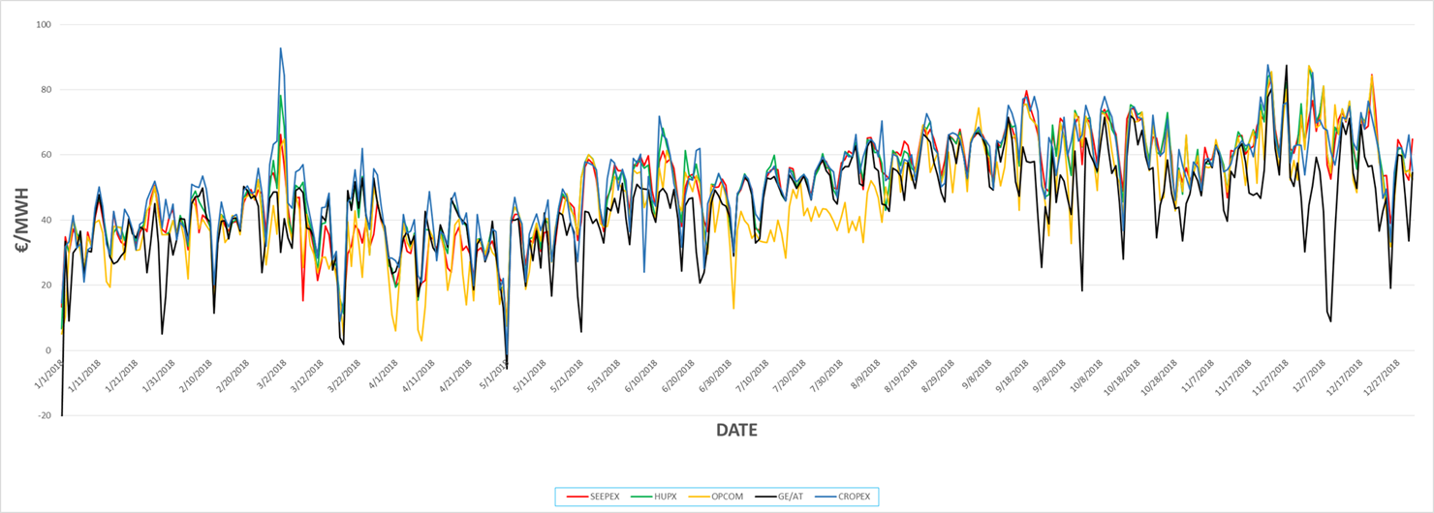
Binding reciprocity between EU MSs and EnC CPs -missing piece to the puzzle
Day-ahead market price convergence in South-East Europe (2018)
    Source: SEEPEX, Serbia

Slide 11
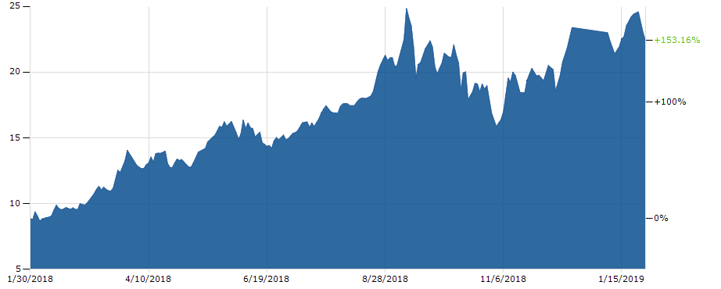
Binding reciprocity between EU MSs and EnC CPs -missing piece to the puzzle
European CO2 emission price development (2018-2019)

Slide 12
Challenges to regional electricity market development
Legal/
Financial/
administrative
3rd Energy Package implementation
Regulatory
National market structure
Lack of products and players
Political/
Institutional
Resolution of borders
Network Codes adoption
Public procurement
VAT harmonisation
Recognition of licenses
Excessive price regulation
Inadequate framework for new market players (aggregators, prosumers)
TSO/DSO unbundling
State Aid/Competition authorities’ effectiveness
Lack of short-term national markets (DAM, ID, balancing)
NRA independence
BRP exemptions
Lack of data transparency
Excessive public service obligation
Ineffective regulation for protection of vulnerable customers
Retail market foreclosure

Slide 13
Critical issues to the regional electricity market integration in SEE
Legal gap between EU MSs and Energy Community CPs
Slow implementation of electricity market reform in WB6

Slide 14
Legal gap between EU MSs and EnC CPs
EU CACM
EnC CACM
EnC CACM
n.b.: A legally binding solution for CP-MS interconnections is needed (‘reciprocity’)
European Union
Contracting Parties

Slide 15

Providing a legal basis for market coupling
A legally binding solution for CP-MS interconnections requires changes of the EnC Treaty
Progress made in December 2018
The EnC Ministerial Council welcomed the mandate for the European Commission to negotiate Treaty amendments on behalf of the European Union. The Ministerial Council decided to take up again the negotiations on Treaty amendments with particular focus on a reciprocity mechanism, with a view to finalizing them within the first half of 2019, and submit a proposal to the next Ministerial Council meeting (November 2019)
CACM expected to be adopted for EnC in 2019/2020

Slide 16
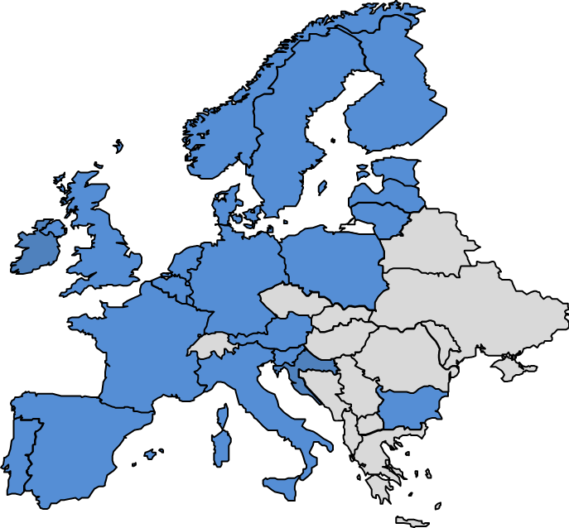
Participation of EnC CPs in Multi-Regional Coupling (MRC)
Cooperation of WB6 and MRC Day-ahead Market Coupling Initiatives initiated
1st meeting held in November 2018 with a view to explore requirements for WB6 stakeholders to join Multi-Regional Coupling
Preconditions for MRC membership
  Harmonised law and rules – national legislation, 3rd Energy Package implemented
  Established PX – a serviced solution is also possible
  Established partnership with an MRC member
CACM application to Energy Community -
  must be clarified before any official step toward the MRC membership of EnC CPs’ stakeholders

Slide 17



Designation of a NEMO – a temporal solution through ECRB Recommendation
Background for the ECRB Recommendation
Importance of a regulatory decision of the NRAs
  Clarification of roles and responsibilities for market coupling is crucial for the performance and implementation of market coupling in the Western Balkans and between the Contracting Parties of the Energy Community and the EU Member States
  Regulation 2015/1222 establishing a guideline on capacity allocation and congestion management (CACM Regulation) provides a minimum harmonisation of provisions concerning single day-ahead and intraday coupling and introduces an obligation on Member States to determine a Nominated Electricity Market Operator (NEMO) and provides the criteria according to which such NEMO shall be designated
  Adoption of the CACM regulation into the Energy Community acquis has not yet taken place
  Regulatory decisions from national regulatory authorities to that extent would provide a number of advantages
Clarity on the
roles and responsibilities
Clear nomination
and revocation
rules
Regulatory
decisions to establish a nomination procedure
Comprehensive
list of nomination
criteria
  Recommendation to establish an alternative temporal solution for the designation of NEMOs in non-EU jurisdictions, which aim to couple in a compatible manner with the CACM Regulation.
17

Slide 18
Berlin process
Political commitment to improve connectivity in Western Balkans
WB6 MoU on regional electricity market development
WB6 and 15 EU MSs signatories
Grant Contract EU-ECS
Financial support to connectivity EUR 1 mill.
Facilitating, monitoring and reporting
Energy Community Secretariat
    Western Balkans 6 Initiative

Slide 19

Implementation of measures towards electricity market reform is characterised by the very modest progress
58% - Nov 2018
53% - Nov 2017

Slide 20
Benefits of cross-border cooperation
Day-ahead market coupling
Reliable price signal, increase of liquidity and improved utilization of interconnection capacity (10-20%)
Cross-border balancing market
Better utilization of balancing resources and improved security of supply
Coordinated capacity calculation and allocation
Efficient usage of interconnectors

Slide 21
Functional WB6 day-ahead markets – prerequisites for market coupling
DAM operational:
  Serbia- SEEPEX (2016)
DAM establishment ongoing:
  Montenegro
  FYR of Macedonia
  Albania (Kosovo*)
51%
DAM establishment stalled:
  Bosnia and Herzegovina

Slide 22

Day-ahead market coupling in South-East Europe
Montenegro-Serbia
Serbia – 4 MMC
WB6 Day-ahead Market Integration Programme
Steering Committee Market Coupling Roadmap
FYR of Macedonia- Bulgaria
Bosnia and Herzegovina with Croatia,
Montenegro and Serbia
Albania – Kosovo*
Albania-Italy-Montenegro-Serbia
Albania - Greece

Slide 23
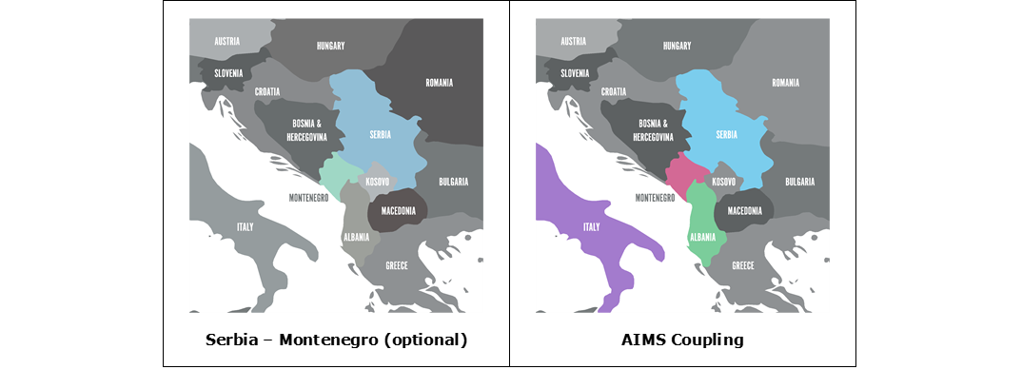
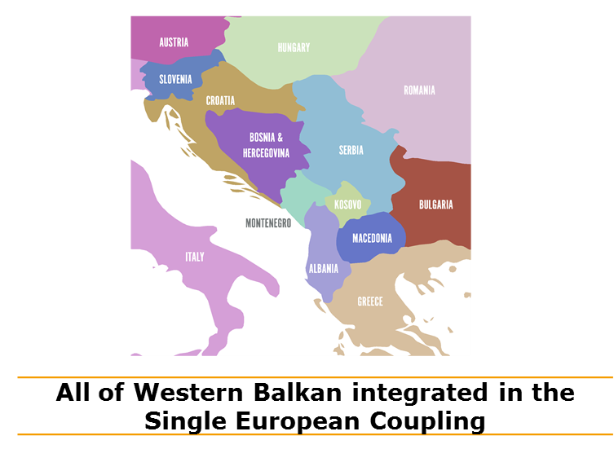
A sequence of market coupling unclear - an integrated roadmap under development
23

Slide 24

    Cross-border electricity balancing in WB6
    Implementation supported with technical assistance provided under WB6
    A detail legal analysis of gaps between the current legislation governing electricity balancing in WB6 parties and EU guidelines conducted
    The imbalance netting platform was tested using the real-life data provided by the transmission system operators of WB6:
      Annual saving of EUR 16 million estimated if imbalance netting is applied at the level of all WB6
    A platform for the manually activated Frequency Restoration Reserve and Replacement Reserve was also tested:
      Preliminary results of the test showed potential savings of EUR 4.3 million.
    Catalog of measures and implementation roadmap developed
    Next step:
    WB6 TSOs to take actions to implement regional platforms

Slide 25
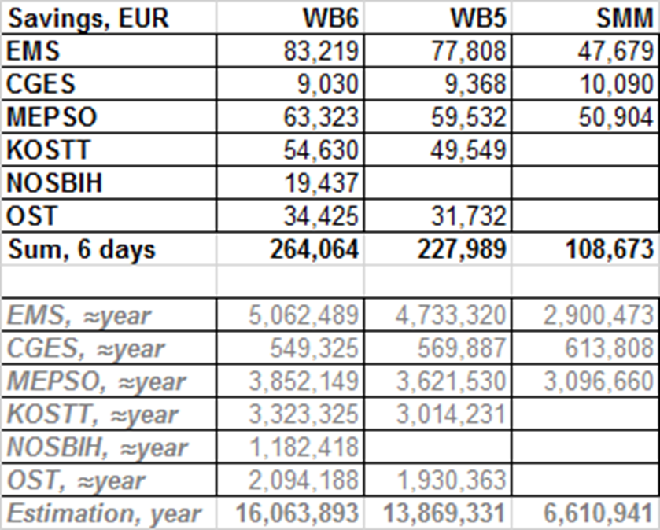
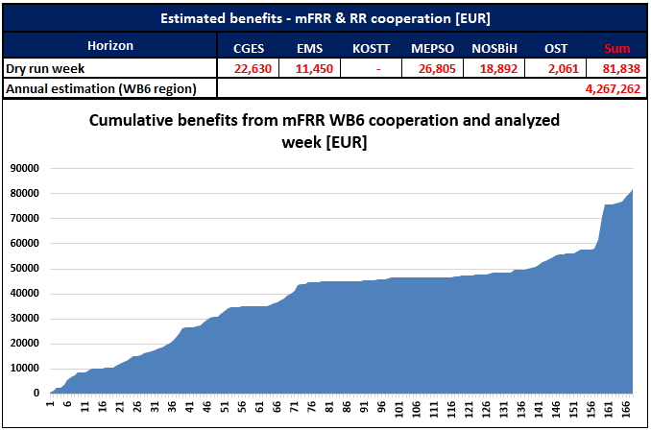
Imbalance netting cooperation
mFRR&RR cooperation ∼ 4.3 mill savings

Slide 26
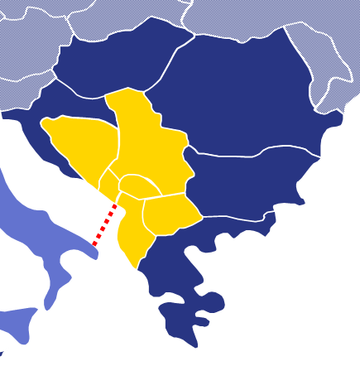
    Regional coordinated capacity calculation in WB6
    Implementation supported with technical assistance provided under WB6
    Objective: WB6 TSOs to apply a coordinated capacity calculation process on a D-2 timeframe in order to ensure implementation of market coupling
    Draft methodology for coordinated capacity calculation in the region of the WB6 including also borders with the surrounding EU Member States, together with a detailed explanatory document developed
    Next steps:
    WB6 TSOs and NRAs to take actions towards adoption of the methodology as part of the early implementation of market coupling

Slide 27
    National reforms still to be completed in most of WB6…
    Eligibility and price regulation
    Eligibility right still not given to all customers in:
      Albania, FYR of Macedonia
    Regulation of generation prices still applied in:
      Albania, Bosnia and Herzegovina
    Deregulation of prices for medium voltage customers postponed in:
      Albania, Kosovo*
    Deregulation of prices for small and HH customers postponed in all WB6
      TSO/DSO unbundling still not completed in WB6 parties, except in Montenegro
☞
☞

Slide 28
    Energy transition:
    Recommendation on preparing for the development of integrated national energy and climate plans by EnC CPs (adopted in January 2018)
    Policy Guidelines on the development of national energy and climate plans (adopted in June 2018)
    Energy Community Ministerial Council adopted the General Policy Guidelines on 2030 Targets for the Contracting Parties of the Energy Community (November 2018);
    The Energy Community Study on coal/lignite electricity production related direct subsidies in the Energy Community Contracting Parties about to be finalized
    The Energy Community Study on generation adequacy and capacity mechanisms in WB launched
    ⇒ decarbonisation will require:
      Well-functioning and integrated regional electricity markets
      Introduction of market-based support schemes for RES

Slide 29

Thank you
Jasmina Trhulj
Energy Community Secretariat jasmina.trhulj@energy-community.org

