Slide 1
The Outcome of the Oil Derivatives Market Liberalization
Ottó Grád
Secretary General
Hungarian Petroleum Association

Slide 2
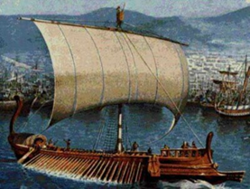
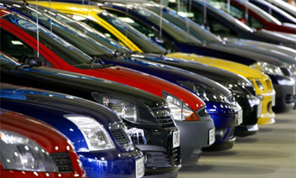
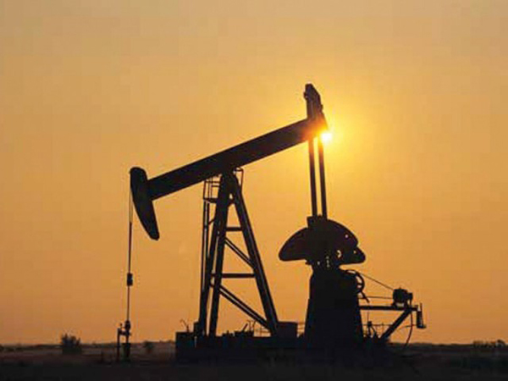
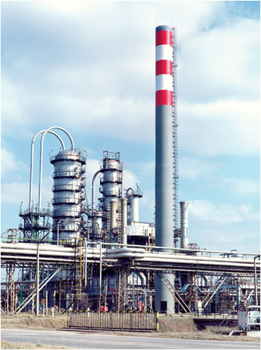
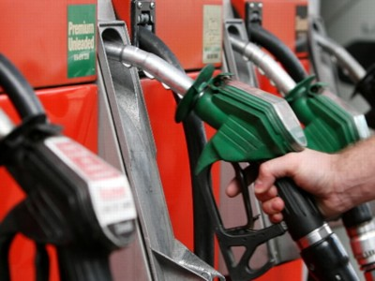
„Navigare necesse est…”
Sailing is necessary… and Driving and Flying!
… So we have to follow Crude Production, Refining and Sales activity!

Slide 3
Members of HPA

Slide 4
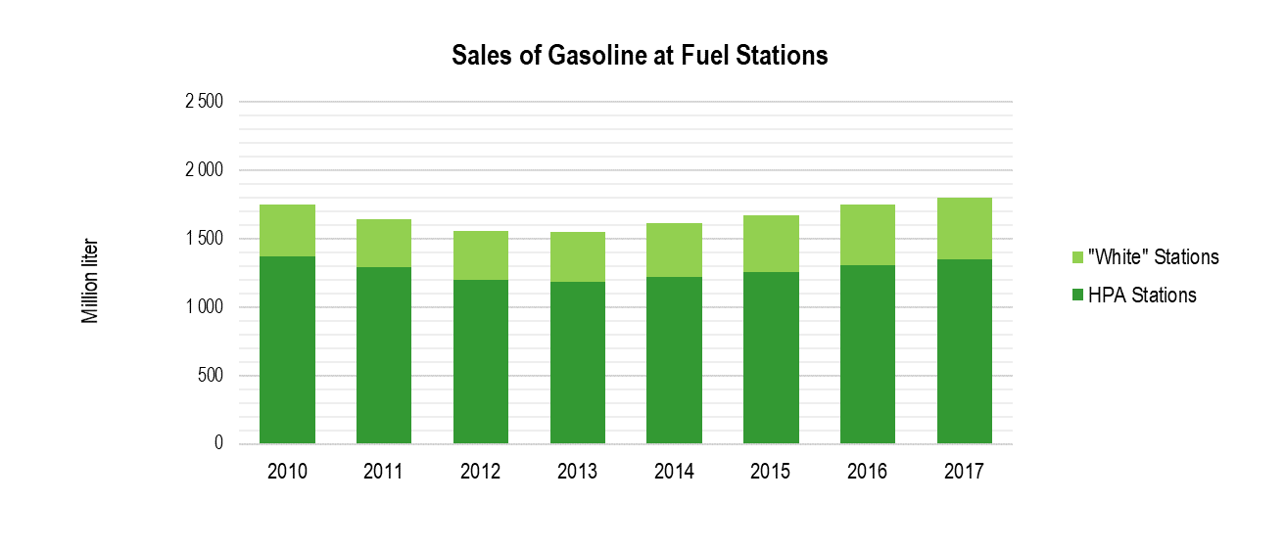
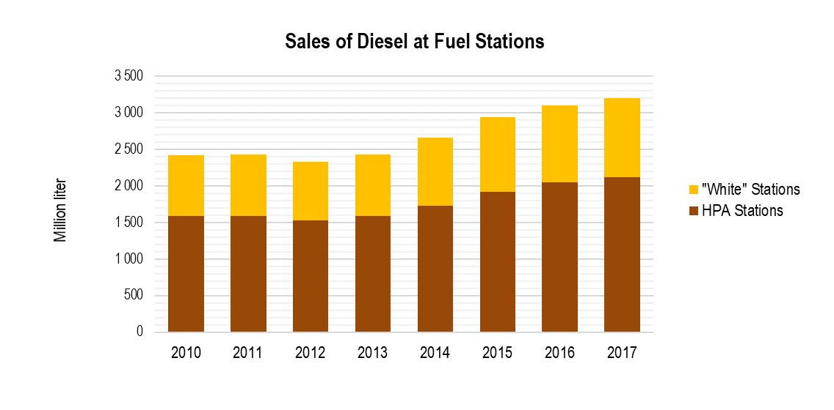
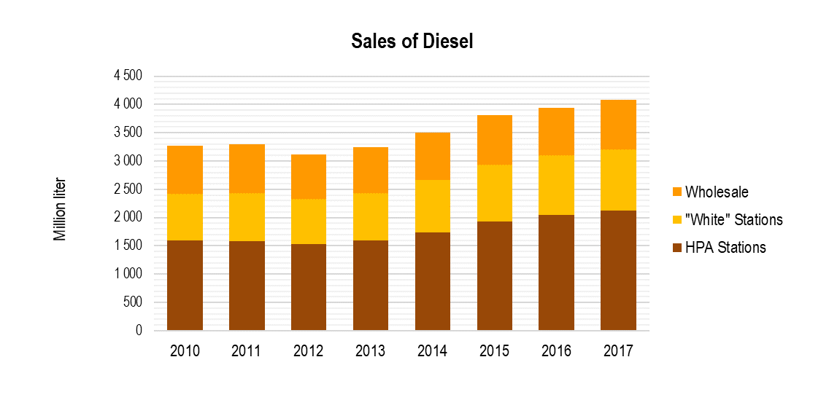
Market Situation I. - Sales of Fuels

Slide 5
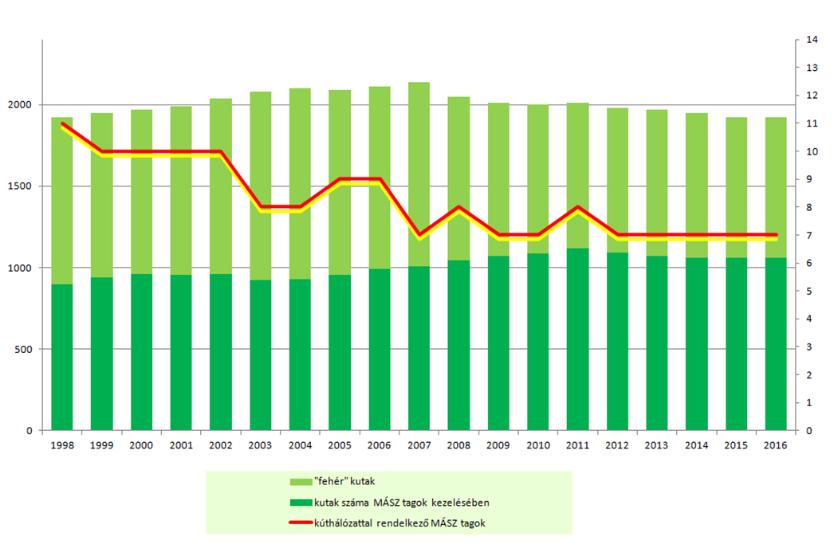
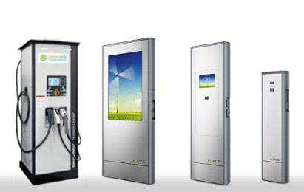
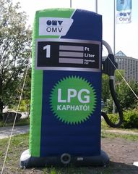
Market Situation II. - Filling Stations
Retail Market (HPA shares)
Gasoline Diesel Total
2017 75% 66% 70%
Number of Members ( Code of Ethics )
Number of Stations ( Share )
High Quality Fuels ( Premium grade, Bio )
Service ( Card, Shop, Washer, Used Cooking Oil )
Alternative Fuels
LPG Autogas
CNG, LNG
Electricity
Hydrogen?

Slide 6
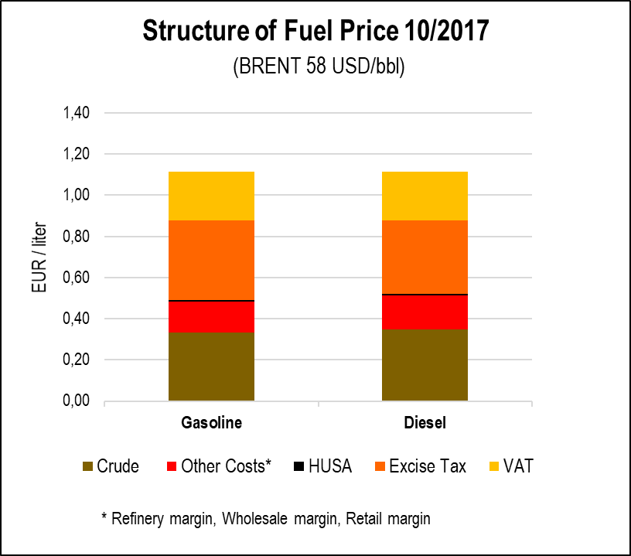
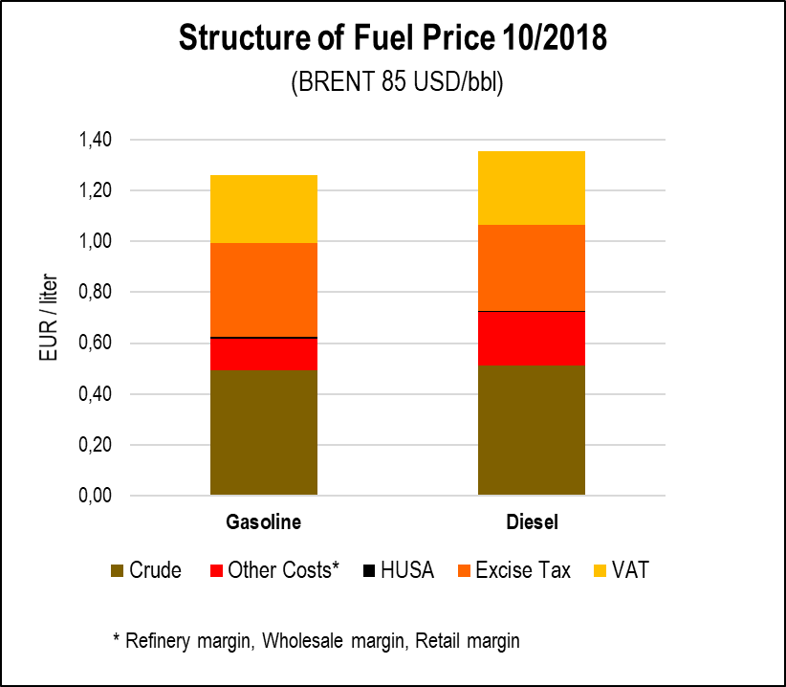
Motor Fuels Competition - Taxation
Tax in Motor Fuels

Slide 7
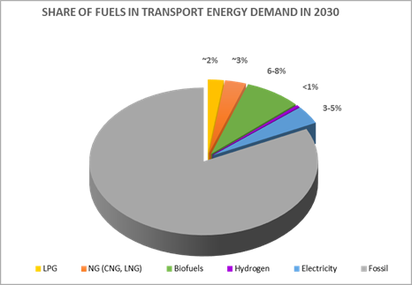
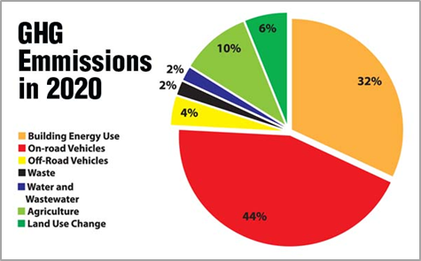
Oil Future
Forecasts (IEA, EU)
Crude Oil will have important roll in the energy sources min. 30 years
More than 80 % of Fuel demand will be covered by Fossil based products in transport sector till 2030
Challenges
Electricity and the electric cars are the best alternatives for the vehicles with Internal Combustion Engine – Today
The environmental protection and the alternative fuels are the greatest challenges for the Oil Industry today and the near future

Slide 8
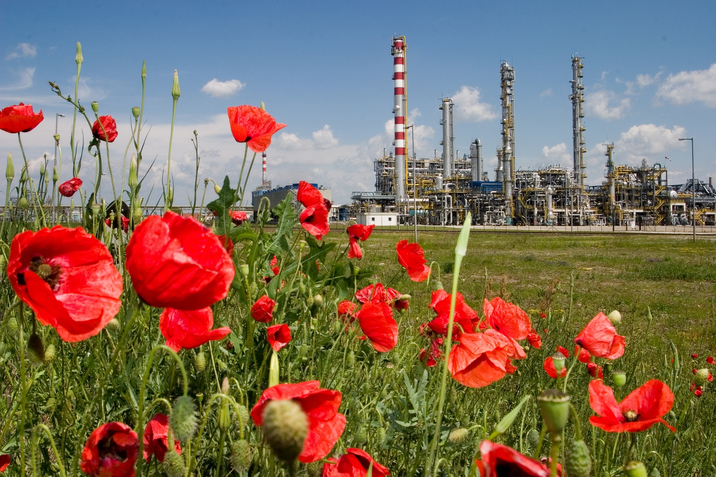
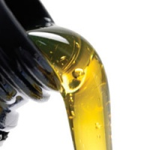
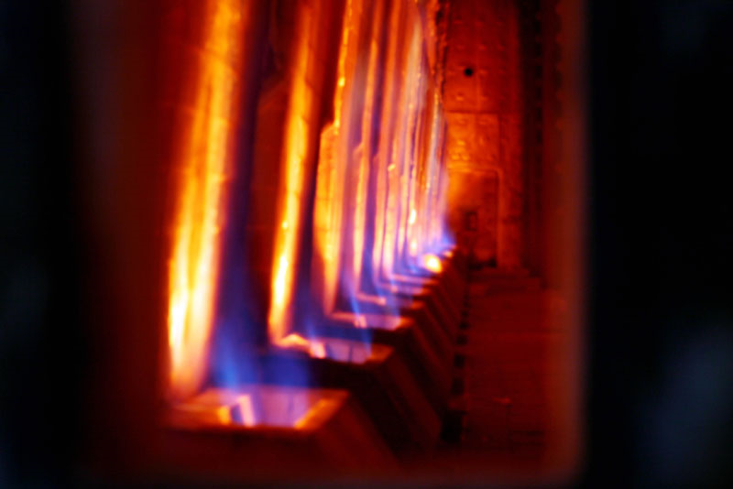
Answer from Oil Industy I. - Refineries
- Changing of yields
MOGAS ↓
DIESEL ↓
NAPHTA ↑
PETROCHEMICAL Products ↑
- New fields
Energy service
New Products
- Bio components
- Special CH
Notes:
↑↓

Slide 9
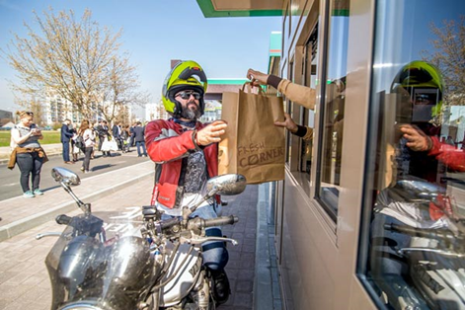
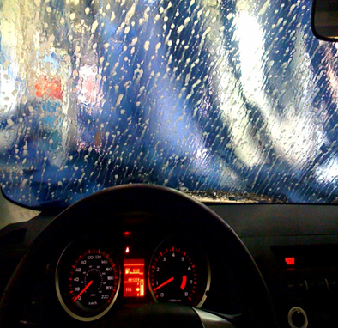
Answer from Oil Industy II. - Retail
- Traditional activity
Petrol Station MOGAS / DIESEL
Gas Station + LPG
+ CNG
+ LNG
+ H2
Filling Station + Electricity
- Additional Service /more time/
Car washing
Shops
Restaurants / Drive in / Pack Points
Post Office
Notes:
↑↓

Slide 10
HPA
www.petroleum.hu

