Slide 1
ENERGY MARKET OF WESTERN BALKANS REGION International Conference WESTERN BALKANS NATURAL GAS MARKET & CUSTUMERS PROTECTION TSO „GAS PROMET“ AD PALE PRESENTATION
Metropol Palace Hotel, Belgrade
October 18th 2018

Slide 2
Company: GAS PROMET AD, Srpskih ratnika 17, 71340 Pale, BiH Core business: Natural gas transportation (TSO) Total transported quantity: 0.241 bcma (2017, 100% of gas entering BiH) To other TSOs: 0.176 bcm (2017, for 2 TSOs: BH Gas & Sarajevogas AD) Established: 1998 www.gaspromet.com
Some specifics of TSO’s TS:
CMP : MS Zvornik, UGS: none , LNG: none, ƞ ≈ 0.3
Delivery parameters at CMP Zvornik ( 136 km from CS):
WP : ≥ 30 bar, Q : 1 860 000 cm/day (≈ 0.7 bcma)
System Users (during last 3 years):
3 from abroad, 3 from BiH
Exits: Sarajevo, industry, CNG, distributions

Slide 3
Natural gas consumption in BiH & Republic of Srpska (1996-2017, million cm)

Slide 4
Is Current pipeline Capacity sufficient for B&H ?
Yes, for reasonable demand, (in 2017: ƞTR = 242/710 ≈ 0.34), but
It barely covers winter daily maximum: (Jan 2017: 1.87 mcm/day)
Daily average consumption (2017): 241/365 = .66 mcm/day
Daily capacity booking (2018): (ƞBK = 0.927) 1.8 of 1.94 mcm/day
Capacity booking (2018): 5/6 FBiH, 1/6 RS
Age of pipeline 39, (1979) (2/3 of average expected lifetime)
Technical measures to mitigate this (booking) situation:
- shaving winter consumption peaks (using auxiliary fuel)
- pipeline weak point reconstruction (up to DP = 50 b)
- construction of Compressor station(s) (Δp ≈ 1/3 at CMP Zvornik)
- construction of UGS in B&H (if feasible/needed)
- creating “gas rings” for better network use (whenever feasible)
- building new natural gas infrastructure. (next 10-15 years)

Slide 5
Existing Pipeline Technical issues - Review
Pipeline is underused, but overbooked (ƞ ≈ 34%)
Older Pipeline (39 y), higher maintenance costs
No UGS in B&H, line pack is limited (L, D, p)
Huge seasonal variations (1:10 ≥ 1:15)
Pressure drop is result of hydraulics (L,D,Q,OP)
A FEW Compressor Stations are missing (min. 1)
OP limit with no serious impact so far (pmax=45 b)
No reverse flows, no gas rings inside B&H
No additional Entry Points (for (n-1), SOS)

Slide 6
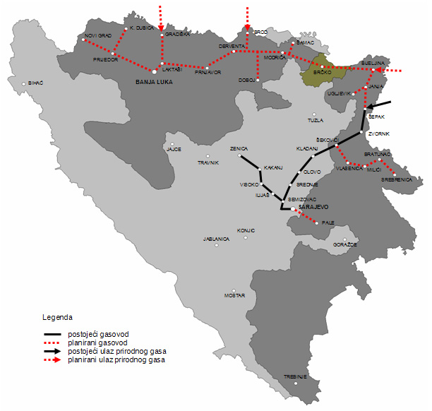
Future development of NG Transpotrtation system in Republic of Srpska
Demand forecast in 2030 0.9-1.0 bcma
(Power & Industry)
First priority:
’’horizontal connection’’
(Sava, South stream, ...)
Second priority:
’’vertical connections’’
Zenica-Doboj (gas ring)
Under construction:
Sepak-Bijeljina (25km)

Slide 7
NG ON B&H ENERGY MARKET
(90+) % Fossil Fuels based B&H Energy Sector
(66% Coal, 25% Oil, 3% Natural Gas) (BiH,2015)
(13% Coal, 43% Oil, 24% Natural Gas, 14% NE, 6% R) (EU 2003)
Unfavorable price relation (electricity vs NG):
(it should be ≈ 3:1 per kWh, ƞTE ≈ 1/3)
Limited growth potential of NG Market
(no real development without TEP & Industry)
(source: Rambǿl, NERA, WB, EBRD Studies)
Uncertainty on gas Supply Routs for EU&SEE
Geopolitics, Economy, EU Gas Market (Reg1%)

Slide 8
Possible Regional Supplay Routs
NABUCO – SOUTH STREAM- TURKISH STREAM ...
INTERCONNECTOR SERBIA-BULGARIA
IAP- TAP-TANAP
KRK LNG
WHAT HAPPENS AFTER 2019?
REGIONAL MARKET (CRO,SRB,B&H) IS 1% of EU NGM

Slide 9
New pipeline projects in Republic of Srpska
Pipeline Shepak-Bijeljina (L = 25 km) is under construction
Under consideration: Batajnica-Bijeljina pipeline,
(20’‘ 102km) as first section of „Horizontal conection“ in RS)
3 pipelines would eventually create (Δ) ring structure with:
- existing pipeline Batajnica-Zvornik,
- Shepak-Bijeljina pipeline (under construction) and
- Batajnica-Bijeljina pipeline (under consideration).
Ring structure (Batajnica-Bijeljina-Shepak) would relax transportation strain on existing pipeline Batajnica-Zvornik
This might be the way to avoid CS construction and provide second entry point (near Bijeljina) for B&H/RS, as well.
This entry point is for “RS horizontal connection” (slide 6).

Slide 10
NG Market in B&H, impact of Regulatory issues
NG Prices are Market created, (no price regulation)
Very end of supply chain (100% imports)
Very Strong competitors for NG (Coal and Hydro)
Regulatory status fully asymetric (RS v.s. FBiH)
NG Transport prices are fully regulated (RS)
Full third party acces since 2012 (RS)
Vulnerable consumers (Government social programe)
Minimal stocks (reserves) (SOS requirements)
(n-1) criterion (SOS requirements)
Final price barely able to compete on energy market

Slide 11
Map of Future EU NG supplay routs? Quo Vadis Gas ? (Proposals for future EU Market)
EU NG Market integration (including TSO mergers)
Tarrif Reform Scenario (EU or Regional TC Faund)
(one entry-exit price for EU or regional markets)
Combined Capacity-Comodity Release Scenario
(50% of gas supply to be sold at firs gas hub)
(50% of capacity reserved for short term contracts)
Downstream and upstream strategic Partnership(s)

Slide 12
Questions? Thanks for Your attention.
Mr. G. Asonja,
TSO Gas Promet AD
Srpskih ratnika 17, 71340 Pale
Republic of Srpska, Bosnia and Herzegovina
direkcija@gaspromet.com
ots@gaspromet.com
www.gaspromet.com

