Slide 1
The SEESARI initiative – “From vision to action“
Dr. Peter Verlič
International Forum- Corridors - Chance for Development of Serbia and Region
Belgrade, 29th March 2017

Slide 2



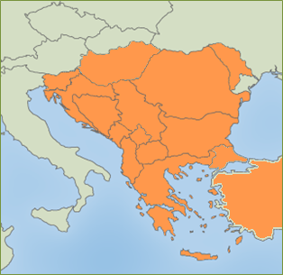
SEESARI - SOUTH EAST EUROPE STRATEGIC ALLIANCE FOR RAIL INNOVATION
Very strong economic potential as the strategic commercial node between Europe and Asia or/and the Middle East in collaboration with Turkey
More than 45.000 km of railway network (UIC Statistics)
147 million tons of goods (railways) (UIC Statistics)
352 million railway passengerss (UIC Statistics)
only 2% of the total freight between Europe and Turkey is carried by rail (The economist 2010)

Slide 3
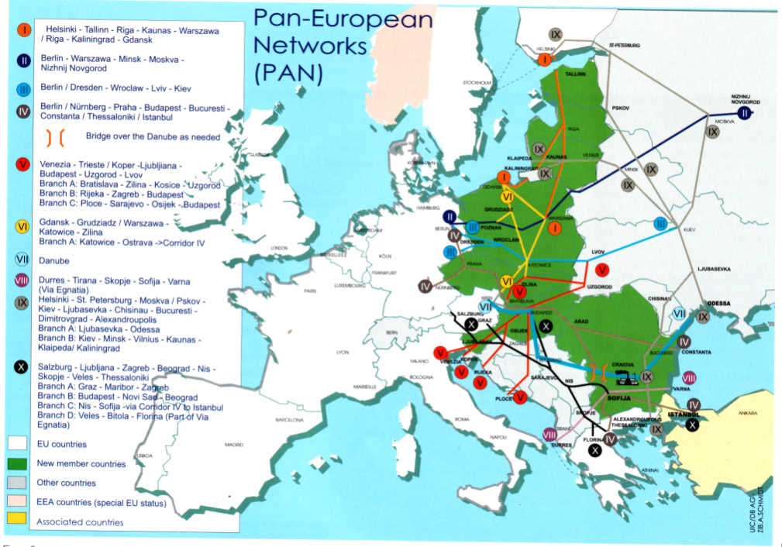
CHALLENGE 2050
Huge Rail Investments in SEE Countries needed
→ One single “Future European Railway System”
EU TEN – T Corridors
Pan European Corridors
NB: South Eastern Europe – Blank!
Extension of the main EU TEN –T Railway Corridors to SEE

Slide 4
SEESARI - MAIN PRIORITIES (7 PILLARS):
HIGH SPEED RAIL NETWORK
INTERGATION OF PASSENGER TRANSPORT
REGIONAL RAILWAY NETWORK
RAILWAY ROLLING STOCK
INTEROPETABILITY AND TECHNICAL STANDARDS
HUMAN RESOURCES
COOPERATION IN FREIGHT TRANSPORT

Slide 5
SEESARI - SOUTH EAST EUROPE STRATEGIC ALLIANCE FOR RAIL INNOVATION
SEESARI priority projects (currently under UIC review):
Harmonization of regional railway lines and services (ReVitaRail)
Integrated cross-border E-ticketing
Development of the High Speed Rail South East Europe
Establishment of Regional Railway Training Center
Development of an innovative incident management system
Optimisation of railway maintenance

Slide 6
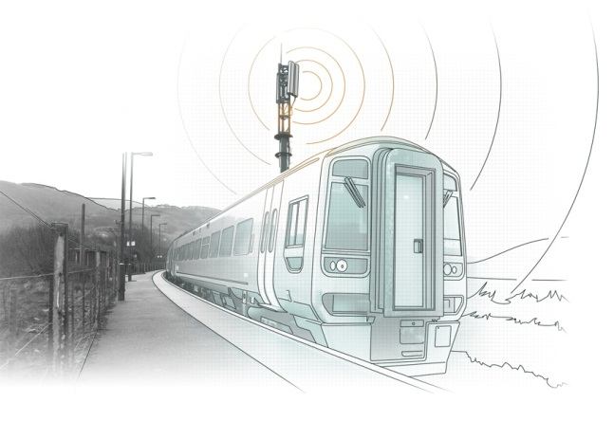
REVITARAIL – HARMONIZATION OF REGIONAL RAILWAY NETWORK AND SERVICES
Challenge in the field of railway transport
Main idea
Harmonization of regional railway network and services
OBJECTIVES
To define and to develop innovative, technical and technological advanced solutions and services in regional railway network with minimum investments in basic infrastructure and maximum added value towards advanced solutions for regional network

Slide 7
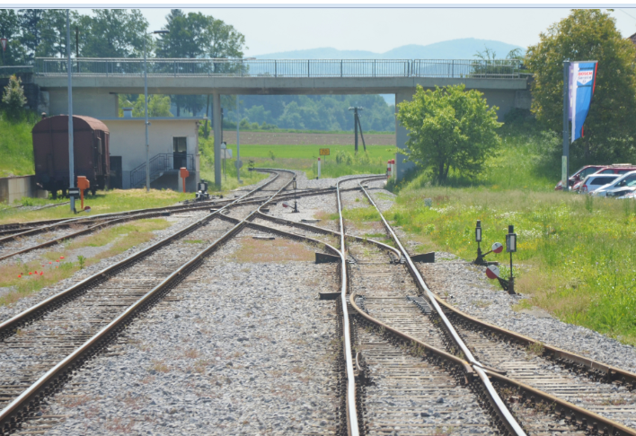
REVITARAIL – HARMONIZATION OF REGIONAL RAILWAY NETWORK AND SERVICES
Better connection of regions and sub-regions
Revitalization and development of rural, neglected and less developed area
Strengthening international cooperation (cross-border regions)
Integration of low costs systems (innovative measures with low minimum investments)

Slide 8
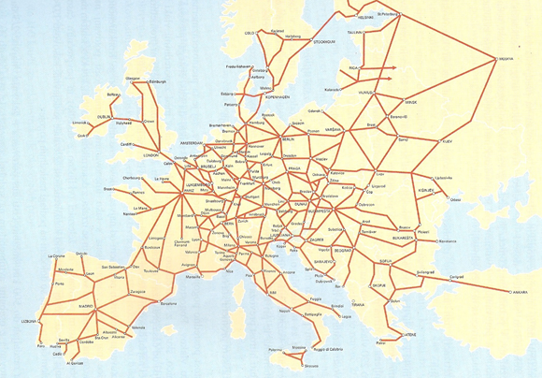
Development of the High Speed Rail South East Europe
High speed network plan (Source: UIC)

Slide 9
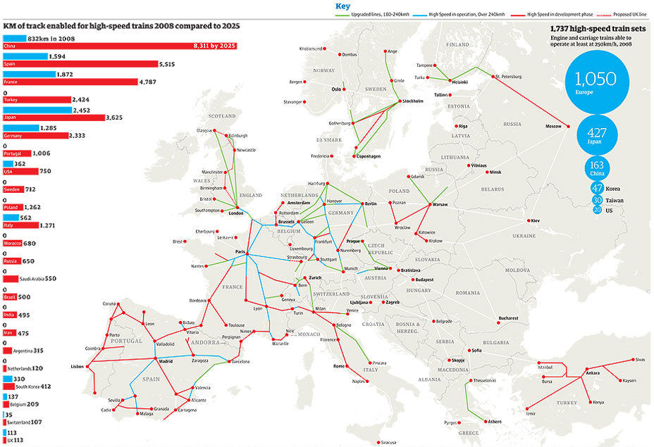
Development of the High Speed Rail South East Europe
High speed network in 2008 (blue), compared to 2025
Source: The Guardian (https://www.theguardian.com/news/datablog/2009/aug/05/rail-transport-transport)

Slide 10



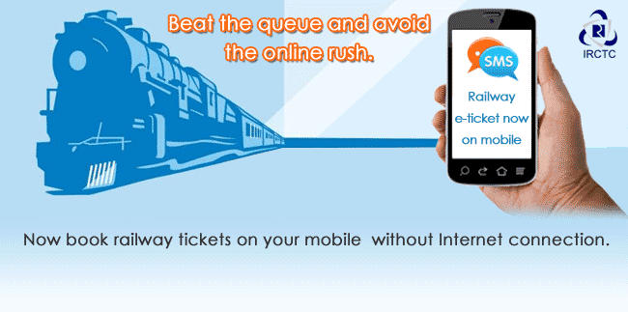
INTEGRATION OF CROSS-BORDER PASSENGER TRANSPORT (IT, TICKETING)
Good opportunity to integrate the Ticketing systems and IT solutions in rail passenger transport
MAIN GOALS:
=> Better competitiveness of rail transport
=> More passengers
=> Integrated rail passenger transport

Slide 11
SEESARI – Participation
SEESARI MEMBERSHIP:
- currently around 50 members from 12 countries
- open for participation
=> Your participation is invited!

Slide 12

Slovenian Railways
Support and contribution of Slovenian Railways towards transport research, development and better connectivity in South East EUROPE
Dr. Peter Verlič
International Forum- Corridors - Chance for Development of Serbia and Region
Belgrade, 29th March 2017

Slide 13
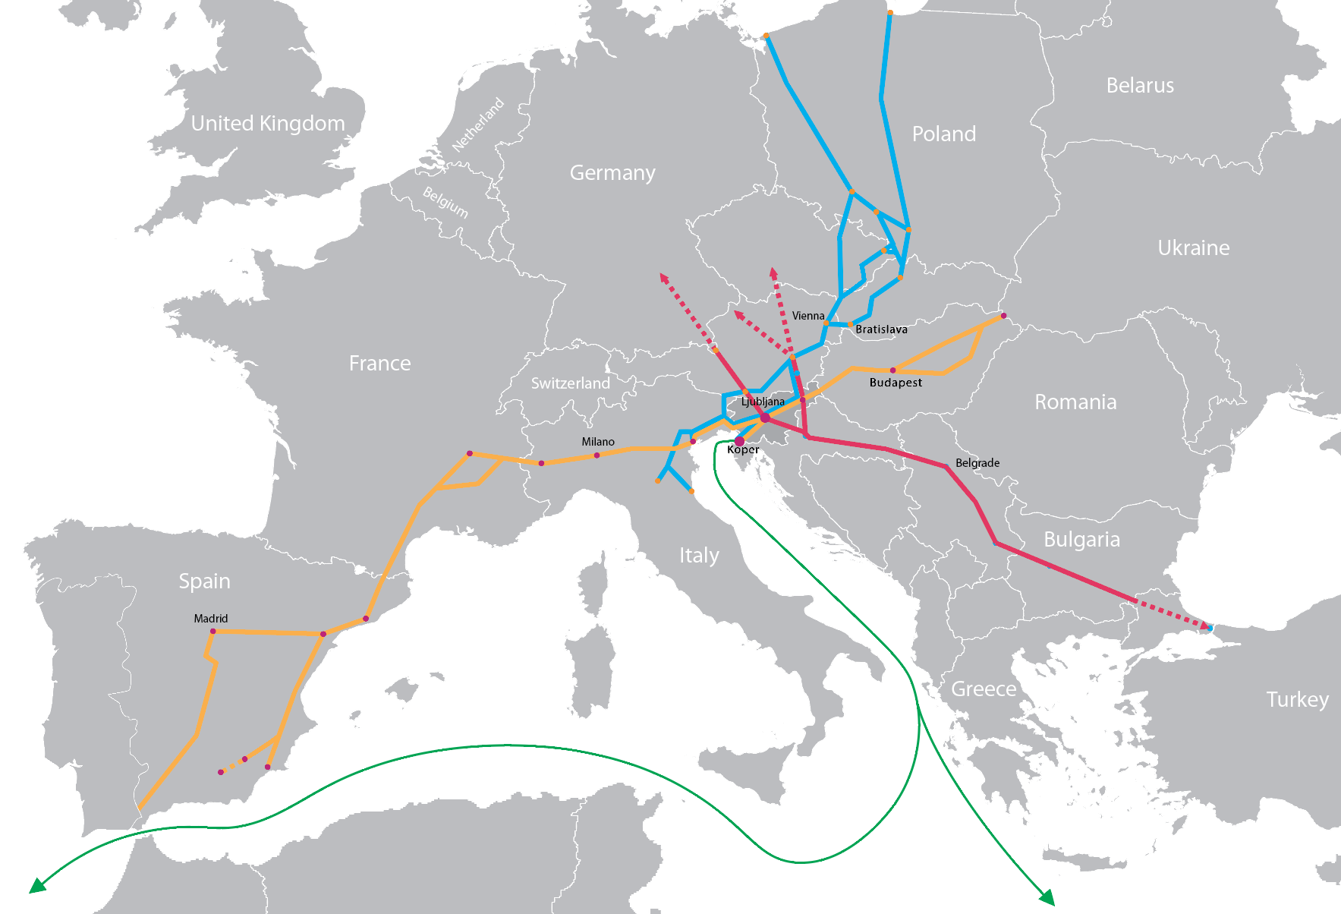
Slovenian Railways – Connecting Central Europe to the Sea
Baltic-Adriatic Corridor RFC 5
Mediterranean Corridor RFC 6
Alpine-Western Balkan Corridor (RFC 10 – in preparation)
SŽ-Cargo is a regional operator on the crossroads of European rail freight corridors.

Slide 14
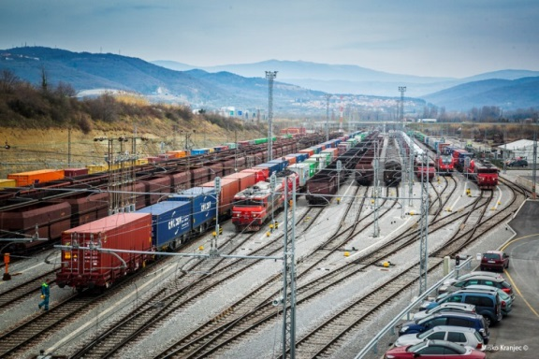
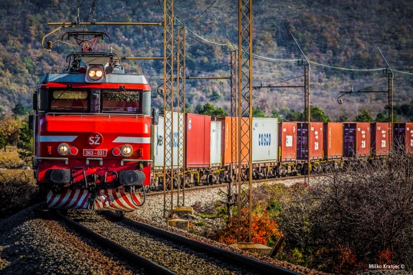
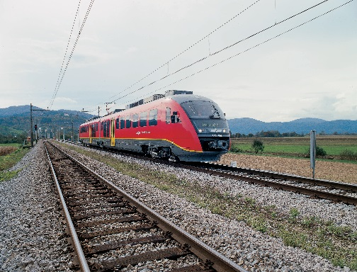
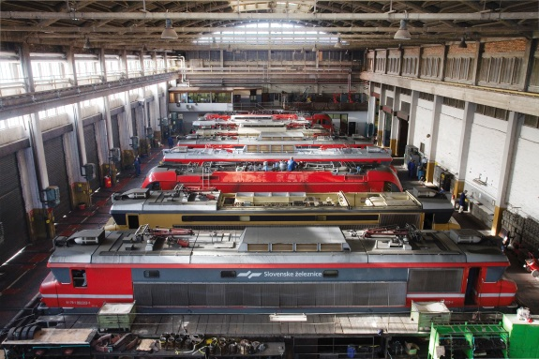
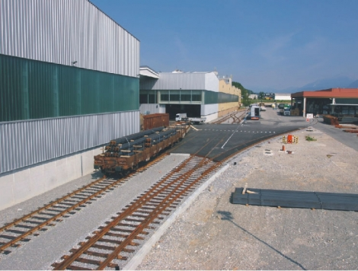
Slovenian Railways – Strategic Activities
INFRASTRUCTURE
MANAGEMENT
FREIGHT TRANSPORT
PUBLIC
TRANSPORT
TRACTION - TECHNICAL SERVICES - MAINTENANCE
CONSTRUCTION
Rail freight services
Conventional
Combined
Logistics and forwarding
Freight terminals and distribution
Engineering
Renewals
New construction works
Management of public rail infrastructure (PRI)
Management of traffic on the PRI
Maintenance of the PRI
Rail services
Bus services
Passenger terminals
(rail and bus)
Traction service for freight and passenger trains
Technical wagon services
Maintenance of rolling stock
SUPPORTING SERVICES OF SŽ GROUP
Facility management, cleaning service, security, printing service, research and development, expert ancillary services

Slide 15
Slovenian Railways – Key Facts of SŽ Rail Network
Line length:
Total 1,207 km
Double-track 330 km
Single-track 877 km
Electrified 503 km
Corridor RFC 6 365 km
Corridor RFC 5 337 km
Number of:
Rail Freight Stations 105
Rail Passenger Stations 115
Railroad Crossings 888
double track
single track

Slide 16
Planned Major Long-term Rail Investments
Construction of a new second track (27 km) on the Divača-Koper line; upgrading of the Divača-Ljubljana line
Upgrading of all major lines to D4 category, Zidani Most-Celje, Poljčane-Slovenska Bistrica and Pragersko node
Infrastructure upgrades to facilitate interoperability on rail freight corridors (ETCS, double-track lines, remote control traffic management system…)
Construction of a second track (16.5 km) on the Maribor-Šentilj line
Construction of a second track (71 km) on the Ljubljana-Jesenice line
Reconstruction of the Ljubljana Traffic Node; upgrading of the switch yard Ljubljana-Zalog
Modernization and expansion of the Ljubljana Intermodal Terminal

Slide 17
Thank you for your attention.
Dr. Peter Verlič,
Chairman of SEESARI
Slovenian Railways/Institute of Traffic and Transport Ljubljana l.l.c Kolodvorska 11, SI-1000 Ljubljana Tel.: +38612914623, +38612914626 Fax.:+38612319277
peter.verlic@prometni-institut.si www.prometni-institut.si
info@seesari.org

