Slide 1


Smart Cities
Nada Suđić, Partner
November 2017

Slide 2

What do we mean with ‘smart cities’?
A city is smart when investments in (i) human and social capital, (ii) traditional infrastructure and (iii) disruptive technologies fuel sustainable economic growth and a high quality of life, with a wise management of natural resources.

Slide 3
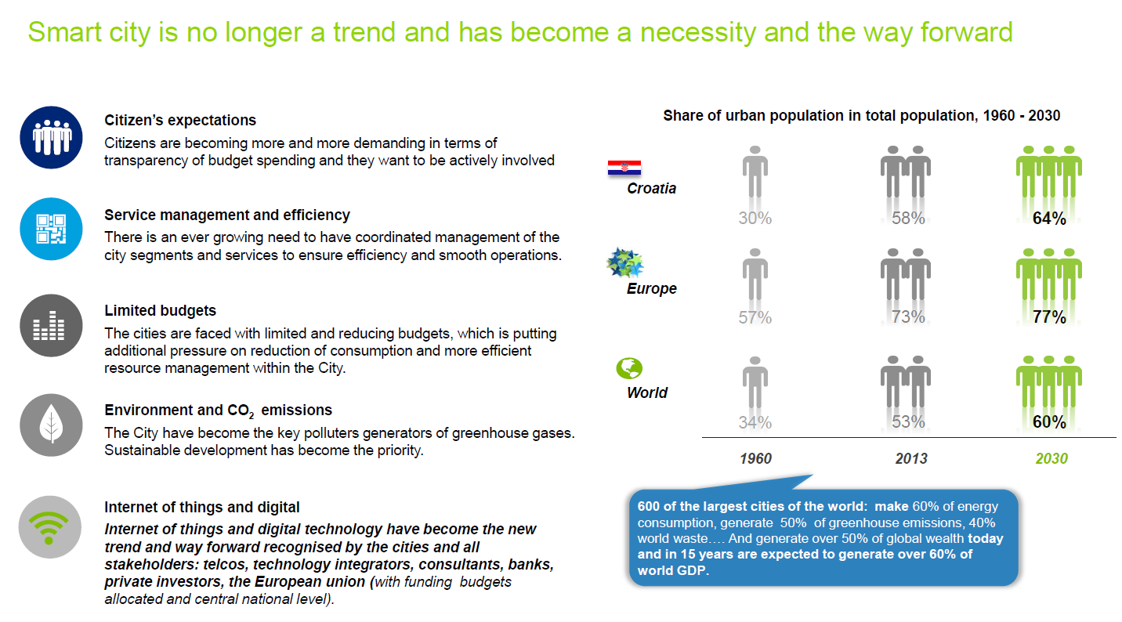
Serbia
Serbia

Slide 4
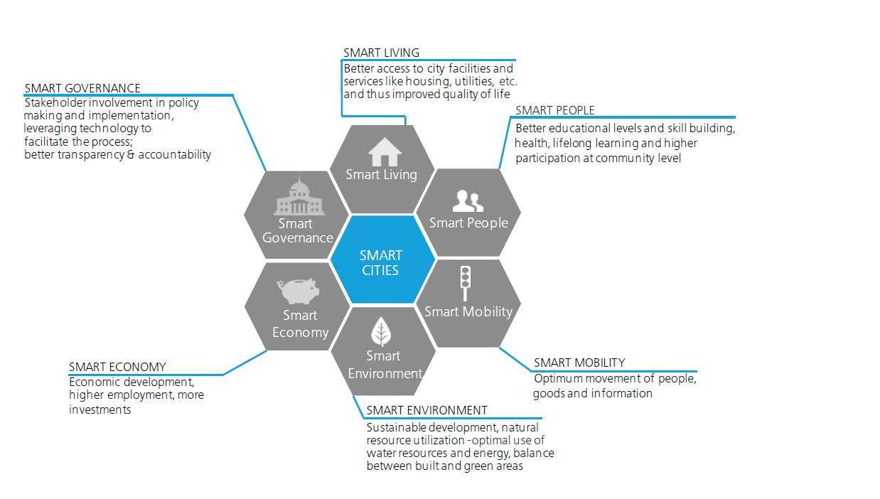
Smart city framework
Water supply
Electricity
Housing
Citizen safety
Sewerage & sanitation
Education
Health
Participation in public life
Participation of communities
Revenue management
Administration
Policy
Transport
ICT
Income levels
Labour market
Poverty level
Pollution
Sustainable resource management

Slide 5
Smart cities emerge as the result of many smart solutions across all sectors of society
Enabling
disruptive technologies
& social innovations
enable
Smart
Mobility
Smart
Safety
Smart
Energy,
Water &
Waste
Smart
Buildings
& Living
Smart
Health
Smart
Education
Smart
Finance
Smart
Tourism & Leisure
Smart
Retail &
Logistics
Smart
Manufac-
turing &
Construc-tion
Smart
Govern-
ment
Goals
Economic growth
Quality of life, a good city to live in
Ecological footprint, sustainability (“planet”)
Challenges
Controlled transition of the labor market due to automation
Winning the war on talent between metropolitan areas
Social cohesion, inclusiveness, solidarity
Secure digital environment, privacy
Resilience

Slide 6
Smart City actor map
A smart city is the result of the efforts of many stakeholders, working together in partnerships of different shape and form. The citizen / user is at the center of the map, indicating that successful smart cities are always user-centric.
City
Government
State /
National
Government
Public
Housing
Associations
Health Care Providers
Universities
/ Schools
Energy Providers
Research
Institutions
(Public) Transportation
Providers
Startup
Incubators
Citizen /
User
Investors
Digital
Agencies
Banks / Insurance
companies
Retailers
Hotels, Museums,
Restaurants, Theaters, Stadiums
Manufacturers
& Construction
companies
Telecom
Providers
Logistics
Providers
Technology Vendors

Slide 7
The six roles of city government
Smart cities require a government that is able to combine six vital roles. To be most effective, city government must make deliberate choices on the mix of roles through which it engages city challenges in the most effective way.
STRATEGIST & ADVOCATE
Sets out a clear direction for the city: what is our vision and ambition as smart city and how do we want to realize this? Furthermore: be an active advocate of the city as innovative hub for new business.
SOLUTION ENABLER
DIRECTOR & REGULATOR
Build ecosystems by gathering parties that normally do not work together to deliver creative new solutions that neither of the parties could have realized on its own.
Create or change laws and regulations to allow new business models and disruptive entries, and simultaneously protect the interests of citizens and users of the city.
STEWARD
CONNECTOR & PROTECTOR
Create an environment in which new businesses and smart solutions can emerge and grow. For example by providing ‘open data’ and by facilitating start ups.
Secure modern transportation infrastructures, energy grids and digital networks. Set standards and take measures to make these vital infrastructures resilient and safe.
INNOVATOR & INVESTOR
Apply the principles of innovation in the internal organization and processes. Stimulate innovative solutions by acting as launching customer.

Slide 8
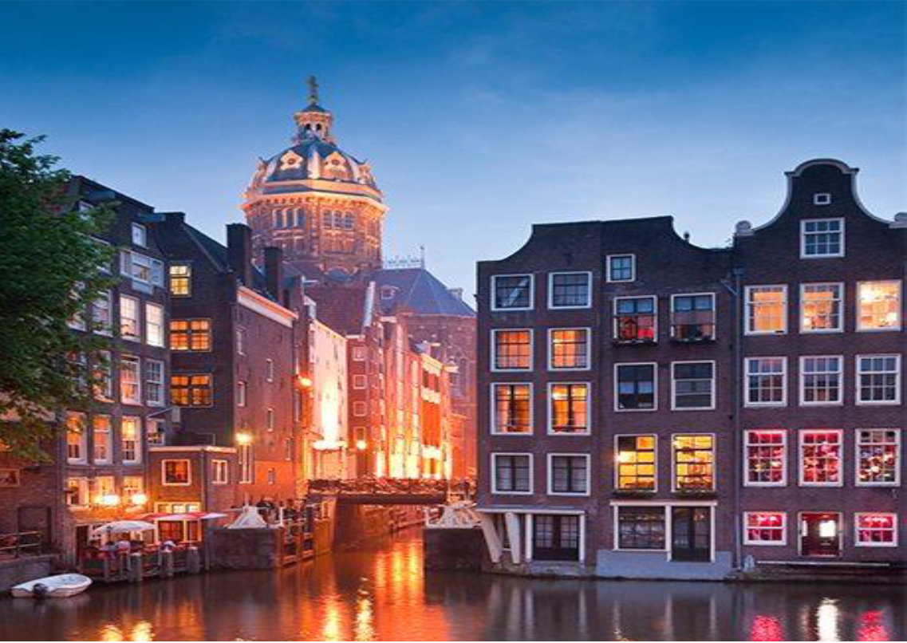
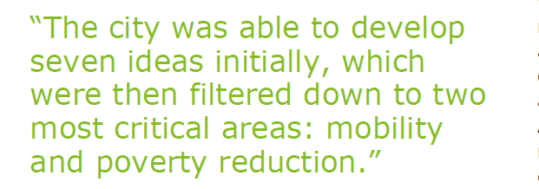

Client story - Amsterdam
The city of Amsterdam is capitalizing on smart city initiatives through forward-looking planning, adoption of a strategic plan, and the creation of a city innovation accelerator. This resembles a top down approach to smart city development.
Amsterdam’s smart city recorded 9-14% savings on energy bills, with projected 40% reduction in carbon emissions by 2025.

Slide 9
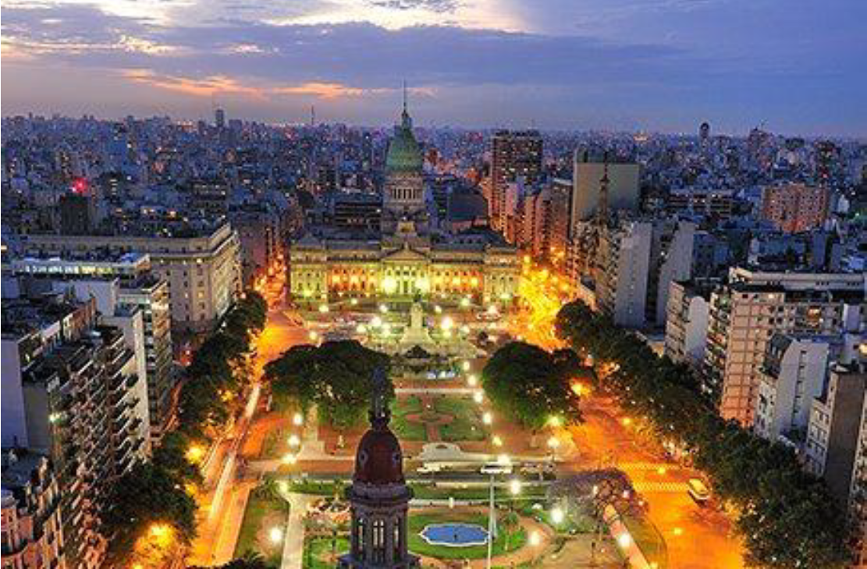
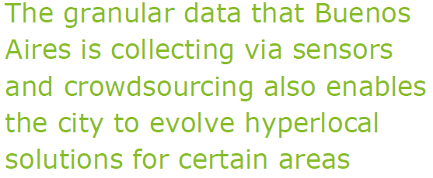
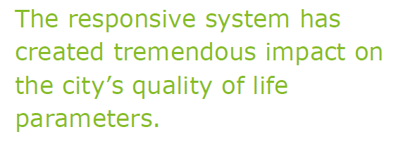
Client story – Buenos Aires
The city of Buenos Aires implemented a technology solution, which involved a new user journey, to better manage 27,000 paved blocks, 56,000 sidewalks, 1,000 green spaces, and more than 1 million physical objects such street lights. The phased approach represents a more bottom-up approach.
The average time to resolve complaint decreased by 93% without additional budget, while satisfaction indices increased e.g.:
Streets works index – 13 to 45
Public lighting index – 19 to 51
Green space satisfaction index – 49 to 76

Slide 10
How can Deloitte assist?
Help cities with the development of appropriate smart city strategies that identifies relevant smart city projects and sequences the projects
Assist cities in adopting a user/citizen centric approach, working in a structured way to place citizens experience in the center of each smart city project
Help cities in developing clear roadmap and step-by-step approach
Help cities develop techniques and approaches for managing risk to privacy and cyber-security
Provide advisory services related to financing, e.g. public private partnership
Assist cities in identifying opportunities to lower operating cost and increase revenues through new revenue streams
etc.

Slide 11
Deloitte refers to one or more of Deloitte Touche Tohmatsu Limited, a UK private company limited by guarantee (“DTTL”), its network of member firms, and their related entities. DTTL and each of its member firms are legally separate and independent entities. DTTL (also referred to as “Deloitte Global”) does not provide services to clients. Please see www2.deloitte.com/rs/en/about-us to learn more about our global network of member firms.
© 2017 Deloitte Serbia

