Slide 1

Smart Cities & Smart Grid
Urban Efficiency
Josip Aleksić
Smart Grid Specialist – SEE zone

Slide 2

Schneider Electric, the Global Specialist in
Energy Management and Automation
€26.6 billion
FY 2015 revenues
~5%
of FY revenues devoted to R&D
160,000+
people in 100+ countries
Four integrated and synergetic businesses
FY 2015 revenues
Balanced geographies – FY 2015 revenues
27%
North America
26%
Western Europe
Buildings & Partner
Industry
Infrastructure
IT
29%
Asia Pacific
18%
Rest of World
Notes:
Schneider Electric is the global specialist in energy management and industrial automation. We create products and solutions that improve the quality of life for our customers – from the office buildings and industrial complexes where they work, to the homes and apartments where they live. Our company has a unique and focused mission: to bring our industry-leading expertise to our customers and to make sure that life is on for everyone across the world.
A Global Company with a Unique Local Presence
Our integrated solutions are offered in more than 100 countries across multiple market segments, including leadership positions in utilities and infrastructure; oil and gas; food and beverage; water and wastewater; metal, mining and minerals; smart cities; finance and cloud; machine manufacturers; data centers and networks; and in residential and non-residential buildings.
Sustainability: The Core of Our Business Strategy
We ensure that we minimize environmental impact, both with our company’s CO₂ footprint and with the products and solutions we deliver to our customers. Quality products, services and solutions, coupled with our customer interactions within sales, marketing, supply chain and customer service, generate confidence in our company.
160,000-plus employees achieved sales of €27 billion in 2015
We devote about 5% of those annual sales to research and development. From devices to big data, we are focused on developing new technologies and services that will drive intelligence, efficiency and connectivity for our markets, globally. With a base of best-in-class technology, we deliver integrated solutions across a broad section of industries.
Industry produces more with less. Buildings and homes become more safe, secure and efficient

Slide 3
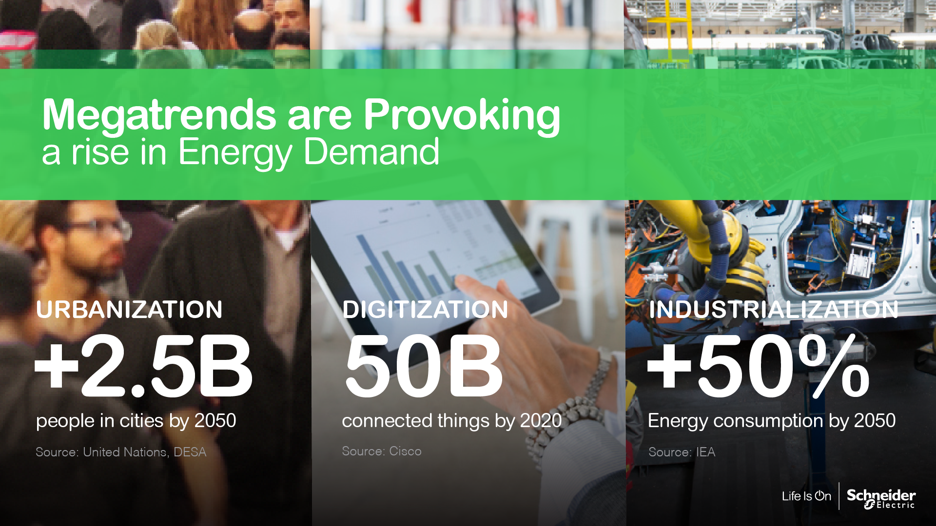
Notes:
Recommended Script :
Cities are at the convergence of major megatrends.
Urbanisation is driving a global agenda.
By 2050, the world’s cities will be home to an additional 2.5 Billion people. Imagine the stress on infrastructure, on transportation, on public services. The number of cities with more than 10M population is going to almost double to 41 in 2030. Cities need to look into new ways of achieving efficiencies – most importantly energy efficiency. To be a livable city, you have to be energy efficient.
CLICK TO BUILD SLIDE
Digitisation is an accelerating opportunity that cities can leverage to cope with the new urbanization pressures. Digitisation opens new opportunities to manage and integrate city infrastructure to support a growing population and still maintain quality of service.
CLICK TO BUILD SLIDE
This bring us to Industrialisation. As populations migrate to urban areas in search of new employment opportunities, cities have a key part to play in attracting job creation while maintaining a livable environment.
NEXT SLIDE
Additional Datapoints:
Urbanisation:
Globally, more people live in urban areas than in rural areas, with 54 per cent of the world’s population residing in urban areas in 2014. By 2050, 66 per cent of the world’s population is projected to be urban adding more than 2.5 billion people in cities. There were only 10 cities with more than 10M population in 1990. Today, there are 28 and by 2030 there will be 41!
37% of this new growth in urbanisation is coming from India (404M), China (292M) and Nigeria (212M).
Source : http://esa.un.org/unpd/wup/Highlights/WUP2014-Highlights.pdf
We can also talk about cities
Cities above 10M people: 10 in 1990, 28 today, 41 by 2030
Cities above 500k people: 560 in 1990, 1,000 today, 1,300 by 2030
Urbanization increase = +2.5b people in cities by 2050
Residential and commercial buildings account for 1/3rd of total world energy consumption ( This implies continuing rise in energy demand )
Year Population % Urban
2014 7,2bn 54% 3,9bn
2050 9,5bn 66% 6,3bn Difference is 2,4bn
What about the mega trend of the booming world population ?
1,5B people in 1950
7,2B People in 2014
9-10B People by 2050
This in itself is a historical massive change, and the access to secured energy (as well as health services, food & water) is the real challenge of the century.
Digitization
I am sure at least half of us in this room have already watched or will watch at least 1 video – from any source -- today. Videos are fun. We all love it. Especially our kids. Imagine this… more than 3 billion Facebook videos are viewed daily and 300 hours of video uploaded to Youtube every hour! According to IDC we generated some 1.8 zettabytes (1.8 trillion gigabytes) of data in 2011. It is predicted that in 2020 we will generate 40 zettabytes!!! We are digital beings in a digital economy...
This implies a continuing rise in energy demand, including those consumed by the data centers that power the digital economy – think connected machines and devices -- 50Bn connected things by 2020
Data centers alone = 1-2% of total world electricity consumption, but the entire ICT sector = 10%.
Consumption doubled btw 2000/2005, and grew at +56% btw 2005-2010.
Digitization is also changing lives : Faster, simpler, more collaborative – More efficient
Industrialisation:
Industries account for 1/3 rd of the total world energy consumption. This global industrial energy use is projected to double by 2050 in the absence of any new policy measures, and even with the ambitious emissions reduction policy changes, we will still see an increase by at least 50% by 2050. (IEA, 2009c). The IEA, in fact, is estimating that 55% of the additional energy demand in the next 20 years to come from Asia.
Sources :
http://www.unido.org/fileadmin/user_media/Services/Energy_and_Climate_Change/Energy_Efficiency/Benchmarking_%20Energy_%20Policy_Tool.pdf ( Page 17 )
As discussed earlier, the change in our world is more profound than ever. We all know that there is a rise in energy demand – in fact, it will double in the next 40 years. But this rise is also bringing with it new efficiency opportunities in three key areas...
Lets discuss Urbanisation first.
By 2050, the world’s cities will be home to an additional 2.5 Billion people. Imagine the stress on infrastructure, on transportation, on public services. The number of cities with more than 10M population is going to almost double to 41 in 2030. Cities need to look into new ways of achieving efficiencies – most importantly energy efficiency. To be a livable city, you have to be energy efficient.
Digitisation is next.
By the end of the day, I am sure most of us in this room would have streamed a video or a few songs. We download 7 million songs and watch 4 Billion videos on YouTube a day! Think about the whole value chain that is making this possible. It is not just entertainment. Digitisation is pervasive -- in our homes, in our buildings, in the cloud and in our industries. There will be 50 Billion more connected devices and things in the next 5 years. This not only implies a continuing rise in energy demand, but also presenting us with amazing efficiency opportunities.
This brings us to Industrialisation, a huge innovator of efficiency. Industries account for 1/3 rd of the total world energy consumption. This global industrial energy use is projected to double by 2050 in the absence of any new policy measures, and even with the ambitious emissions reduction policy changes, we will still see an increase by at least 50% by 2050. (IEA, 2009c).
JPT Talk Track:
We know that the demand for energy will keep booming and growing under the pressure of three megatrends:
The first is Urbanisation:
Urbanisation is the Century’s biggest event
Think about it – we will build as many cities in the next 40 years as we have had since the beginning of humanity
The figures are staggering – over the next 30 years – we will urbanise 70 million people every year.
This is like building 7 new cities as big as Paris each year
So, if you think the current cities are congested, polluted and unbearable, we have a collective responsibility to make sure these new cities are truly livable
Asia is urbanising at a more rapid rate than any other region in the world – the United Nations projects that Asia will become 64 percent urban by 2050.
Source: United Nations, Department of Economic and Social Affairs, Population Division (2014). World Urbanization Prospects: The 2014 Revision, Highlights (ST/ESA/SER.A/352).
The second megatrend of this century is Digitisation:
We know the first episode of the internet – it is about communications between people-to-people
We are now entering into the second episode of the Internet – it is going to be over the next five years
It is about connecting people-to-devices, people-to-machines and devices-to-devices
Over the next 5 years we will connect to the web 20X more devices than new people
So there will be lots more traffic, data, storage and energy consumption
The third megatrend that is pushing for Energy is Industrialisation:
Industry is already >30% of the world energy consumption
This is going to increase by 50% in the next 35 years
So on one side there is this massive push for more energy from modernisation…
Additional Comments:
As discussed earlier, the change in our world is more profound than ever. We all know that there is a rise in energy demand – in fact, it will double in the next 40 years. But this rise is also bringing with it new efficiency opportunities in three key areas...
Lets discuss Urbanisation first.
By 2050, the world’s cities will be home to an additional 2.5 Billion people. Imagine the stress on infrastructure, on transportation, on public services. The number of cities with more than 10M population is going to almost double to 41 in 2030. Cities need to look into new ways of achieving efficiencies – most importantly energy efficiency. To be a livable city, you have to be energy efficient.
Digitization is next.
By the end of the day, I am sure most of us in this room would have streamed a video or a few songs. We download 7 million songs and watch 4 Billion videos on YouTube a day! Think about the whole value chain that is making this possible. It is not just entertainment. Digitisation is pervasive -- in our homes, in our buildings, in the cloud and in our industries. There will be 50 Billion more connected devices and things in the next 5 years. This not only implies a continuing rise in energy demand, but also presenting us with amazing efficiency opportunities.
This brings us to Industrialisation, a huge innovator of efficiency. Industries account for 1/3 rd of the total world energy consumption. This global industrial energy use is projected to double by 2050 in the absence of any new policy measures, and even with the ambitious emissions reduction policy changes, we will still see an increase by at least 50% by 2050. (IEA, 2009c).

Slide 4

World Urban Population
6.3bn66%
3.9bn54%
+2.5bn
0.75bn30%
+3.15bn
1950
2014
2050
Our cities will get bigger and there will be more of them
They will have to be smarter and more efficient
Notes:
Sources :
http://esa.un.org/unpd/wup/Highlights/WUP2014-Highlights.pdf
https://www.un.org/development/desa/en/news/population/2015-report.html
Year Population % Urban
2014 7,2bn 54% 3,9bn
2050 9,7bn 66% 6,4bn Difference is 2,5bn
I see 4 key trends which will impact us:
Cities are getting bigger and there will be more of them. In the next 20 years, there will be more than 2.5 billion people in cities, meaning +60% vs 2015.
By 2050, the world’s cities will be home to an additional 2.5 Billion people. Imagine the stress on infrastructure, on transportation, on public services. The number of cities with more than 10M population is going to almost double to 41 in 2030. Today, more than half the world’s population live in cities and the number of urban residents is increasing by 60 million each year – that is two every second. By 2050 nearly 70% of the global population will be urban.
Such daunting statistics have led designers, architects, tech experts, engineers, developers and companies like ours across the world to start imagining, and even begin building, the cities of the future.
Energy and electricity is a critical component of that change…but the rules of yesterday won’t get us there!
Cities need to look into new ways of achieving efficiencies – most importantly energy efficiency. To be a livable city, you have to be energy efficient.

Slide 5

From downtown to suburb, we deliver urban efficiency today
Smart Integration
  Energy and Sustainability Management
  City-wide Infrastructure Automation
  Weather Forecasts
Smart Energy
  Ports
  Electric Utilities
  Gas Utilities
  Prosumers
Smart Water
  Water Utilities
  Parks and Gardens
Smart Built Environment
  Tech Parks
  Offices
  Data Centers
  Homes
  Hospitals
  Schools
  Airports
  Hotels
  Shopping Malls
  Stadiums
  Railway Stations
  Tunnels
Notes:
Recommended Script :
From downtown to suburb, we deliver urban efficiency today.
Our solutions solve today’s immediate challenges and most pressing pain-points across the factors that are fundamental to life in a city – energy, water, and the built environment.
We enable energy and gas utilities to deliver on their promises with better sustainability and flexibility. We also enable a new category of energy sources – the prosumers – owners of renewable energy resources who are both producers and consumers of energy and need to manage that optimally. A fourth category is ports – who have special needs to minimize emissions from large vessels by providing them with clean energy as early as possible in the docking process.
We enable water utilities too, to be more efficient, to manage leaks, and to deal with the times when there is too much water and stormwater needs to be managed. We also think about the end users for water – like parks and gardens who need to be responsible with their consumption.
And the third broad category here is the built environment – which for use includes all types of buildings from individual offices to multi-buildng campuses like technical parks, specialist buildings like hospitals and data centers, and the buildings that make transport possible such as airports, railways and tunnels. Those buildings might be owned by the city, or they might be privately owned, but they all contribute to the environment for citizens, and the overall sustainability and resilience of the city. We don’t build those structures, but we provide everything that owners, operators and tenants need to be able to run them efficiently, sustainably, and with great experience for the tenants and users of those buildings.

Slide 6

Buildings

Slide 7


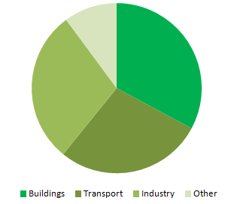


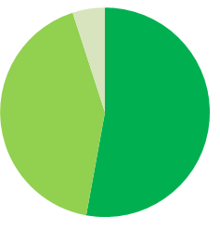


Buildings are the bedrock of cities… and totally rely on electricity and energy
Others
10%
33%
33%
Buildings consume 33% of world energy
33%
29%
Buildings
Industry
Live
Work
28%
33%
Transportation
Buildings consume 53% of world electricity
Electricity consumption in buildings will grow by
80% by 2040
Shop
Relax
42%
42%
53%
53%
Industry
Buildings
Buildings
Study
Get well
Source : IEA, 4Degree Scenario
Notes:
Buildings are the bedrocks of our cities where at its highest level its a concentration of opportunity ( to live, to work, to study, to build, to connect etc ) where we spend most of our time: living, working, shopping, relaxing, studying, getting well.
But it is also the place where 50% of the world’s electricity is being consumed and this figure is expected to increase by 80% by 2040.

Slide 8
Building energy usage will drive the world in the next 40 years
4
2
2
×
×
÷
Energy consumption will double
CO₂ emissions
need to be
halved
We have to become
4 times more efficient
Note: Forecast for 2050 compared to 2009 levels

Slide 9

System Integration

Slide 10

Smart cities need to build their foundation
Integrated and Optimized smart city systems
OT & IT
Optimized city systems Operating Technology (OT)
Legacy city systems
Operating Technology (OT) level
Integrated cross silo city system planning
IT Software & Services
Apps, Analytics & Services
City Focus
Technology Needed
Edge Control
Connected products
Technology Hardware

Slide 11
Our solutions are both vertical and integrated
Smart Energy
Smart Water
Smart Built Environment
Smart Grid
Smart grid asset management
Smart generation
Demand side management
Utility services
Plant & Network Energy Performance
High-performance Buildings
Video surveillance
EV Charging Infrastructure & Supervision Services
Water Distribution Optimization & Loss Management
Workplace efficiency
Microgrid
Tunnels
Gas Distribution Management
District Heating/Cooling Management
Storm Water Management & Urban Flood Control
District and campus-wide building management
Prosumer Buildings
District Energy Management Information System
Data Centers
Efficient
Prefabricated
Managed services
Shore Connection
Irrigation Management
Efficient Homes
Smart Integration
City Wide Command & Control Systems controlling systems at a district level
Energy tracking across buildings, cities and precincts – resource advisor
Asset management, GIS
* Hospitals, industrial facilities, datacenters and commercial buildings
Notes:
This slide shows the details of our offering – broken down by area of expertise, and highlighting our transversal integration capabilities and services.
It demonstrates our deep understanding of each system and of its underlying processes – from both an operational and an architecture standpoint.
This technical expertise is essential to improve the efficiency of the individual systems, especially the most vulnerable ones.
And it is essential to then ensure the efficient integration of all components, in a bottom-up approach.
Note to speaker:
This is our global offering. It varies across geographies as our capabilities, experience and organization may vary in each region & country.

Slide 12

Smart Cities
REFERENCES

Slide 13
We have carried out smart city solutions globally
Aix-en-Provence
Angers
Cannes
Grenoble
Lyon
Nice
Paris
Athens
Budapest
Florence
Genoa
Milano
Naples
Rome
Venice
Verona
Riga
Cluj
Bucharest
Moscow
Novochebksary
Celje
Alicante
Almeria
Avilés
Barcelona
Bilbao
Cadiz
Cartagena
Cordoba
Cuenca
El Ejido
Emasca
(Cordoba)
Huesna
Leon
Madrid
Malaga
Murcia
Oviedo
Palencia
Pontevedra
Sabadell
Salamanca
Santiago de Compostela
Seville
Valladolid
Vitoria
Zamora
Zaragoza
Stockholm
Berlin
Oskarshamn
Høje-Taastrup
Sankt Wendel
Strasbourg
Hirsholm
Ostfold
Buenos Aires
Cordoba
Rosario
Belo Horizonte
Recife
Rio de Janeiro
Sao Paulo
Santiago
Valparaiso
Carrollton, TX
Eugene, OR
Chesapeake, VA
Chicago IL
Clinton, OK
Fairbanks, AK
Columbus, OH
Contra Costa, CA
Farmington, MN
Memphis, TN
Mobile, AL
Puebla City
Radford, VA
Nashville, TN
Newton, KS
Jersey City
New Orleans, LA
Raleigh, NC
New York Statewide
Salem, VA
Palm Beach, FL
Pennsylvania Statewide
Pittsburg, PA
Sherbrooke, Quebec
Oran
Rabat
Tunis
Cairo
Jeddah
Medina
Mecca
Beirut
Abu Dhabi
Haifa
Beijing
Hong Kong
Singapore
Sydney
Chennai
Mumbai

Slide 14
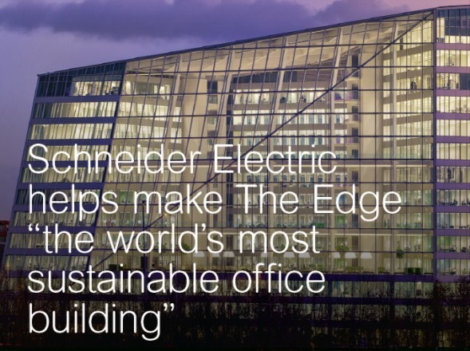

The Edge, Deloitte
Amsterdam, Netherlands
BREEAM-NL “Outstanding” building features
SmartStruxureTM Solution backbone and more
Customer Challenge
Implement a single IP backbone for all building ecosystems with the ability to track and manage data analytics
Employees control room comfort with a third-party smartphone app
The Solution
SmartStruxure™ solution BMS
Power Monitoring Expert
Electrical distribution and field devices
Customer Benefits
Connectivity
Sustainability
Simplification
The Results : Life is On with...
98.36% BREEAM-NL rating,
the highest score ever awarded
“Sustainability is about more than a great BREEAM rating. It is also about a building’s overall comfort and efficiency for its occupants, so that they can operate with ease in a productive and healthy environment.”
Coen van Oostrom
Founder and CEO of OVG Real Estate
Notes:
Additional Information:
http://www.schneider-electric.com/ww/en/download/document/CSS-THE-EDGE-JUNE-15

Slide 15
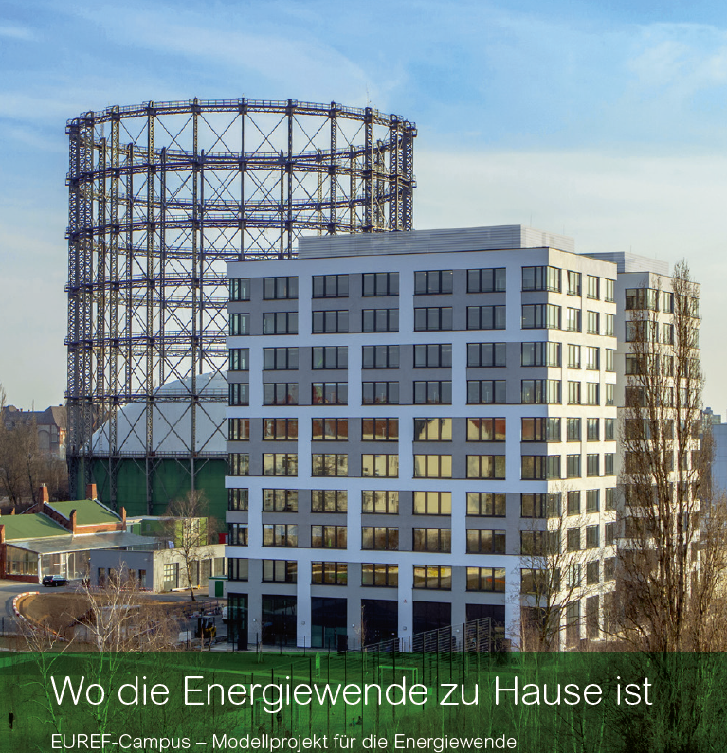
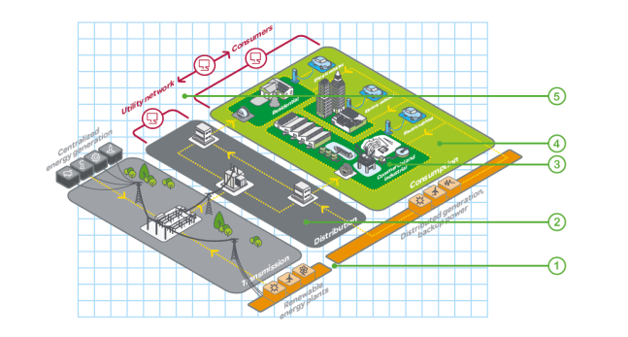
EUREF Campus
Berlin, Germany
Outstanding” building features
SmartStruxureTM Solution backbone and more
Europe's first CO2-neutral district
Microgrid (630 kVA transformer, medium-voltage switchgear, intelligent sub-station, power meters)
Low-voltage switchgear (Prisma power switch)
Solar (Conext TL inverters with an output connected of 20 kW) - for carport and at microgrid
EV charging (36 bays for cars; also charging for buses) – one of the largest in Germany
ClearSCADA (displays entire microgrid, efficient buildings, EV charging, etc.)
Building Automation (Struxureware Building Operation) – integration, comfort features, etc.
Building Management System (Building Operation)
Energy Monitoring System (Energy Operation)
Wall switches, plugs, field devices, etc. all over the campus/buildings
Security – access control (campus and each building), integrated system; door communication system
SE involved in research innovation projects
“"On the EUREF-Campus, the Climate targets 2050 the Federal Government has already achieved - this would be without the intelligent solutions from Schneider Electric impossible! Wherever we Engineers and architects at the end are, Schneider Electric sets yet once and pressed the lemon so right out, thereby saving even more even 30% of energy. " - Reinhard Müller, CEO of EUREF AG
https://www.youtube.com/watch?v=4HnqI6b3ywI

Slide 16

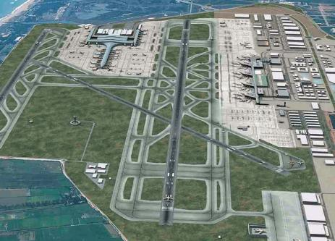
AENA, El Prat Airport
Barcelona, Spain
Command and Control with integration.
Customer Challenge
Ability to handle thousands of signals simultaneously
Information needs to be presented simply and in context for quick response from operators
Existing control platform required knowledge of 20 different technologies and tools; training was complex and costs were high.
The Solution
Wonderware® System Platform
Wonderware InTouch® HMI
Wonderware Historian
Wonderware Information Server
Customer Benefits
Process control for terminal building , cooling and heating power plant, and auxiliary buildings for luggage transport
The Results : Life is On with...
700,000 inputs to monitor and manage 5 control environments.
“The centralization of operations that we get with Wonderware helps manage around 700,000 signals and is essential for a critical infrastructure like this. We can now quickly respond to incidents and also be proactive in optimizing management.”
Jordi Asensi,
Head of Systems and Database Management, AENA Barcelona Airport
Notes:
Additional Information:
http://www.schneider-electric.com/ww/en/download/document/CSS-THE-EDGE-JUNE-15

Slide 17
Smart Grid - Electric network
CHALLENGES

Slide 18
Demand for higher safety and reliability
$50-150 bn
annual cost to US economy following
productivity or revenue losses linked to power outages
Source: Bloomberg New Energy Finance
90%
of all power outages
occur along distribution lines
Source: Bloomberg New Energy Finance
Notes:
Recommended Script :
Safety and reliability has always been and will continue to be the number one operational driver for electric utilities.
A constant focus on providing safe and secure access to energy for customers, and the utility workforce is essential, as well as ensuring that the system is reliable and that the lights stay on !

Slide 19
Increased renewable generation
143 GW
were added to the world's
renewable electricity capacity in 2013,
compared with 141 GW added
by new fossil-fuel plants
Data source: Bloomberg New Energy Finance
140%
of Denmark’s electricity was
generated on 11 July 2015 by wind power and
surplus was exported to neighboring countries
Data source: The Guardian
150%
is the amount by which US non-hydropower renewable generation capacity is expected to grow by 2040
Data source: U.S. Energy Information Administration
Notes:
Recommended Script :
The increase in renewable energy resources to lower environmental risks and secure future capacity, comes from intense pressure and regulations, demanding utilities comply with renewable portfolios and initiatives to encourage clean and efficient energy.
However, as new sources of more localized production appear, utilities struggle to combine traditional power generation with renewables without compromising the way the network is managed.
Most renewables are scattered, while energy demand is often intense and concentrated. Network architectures must be reinvented and upgraded.
The variable nature of renewables complicates load balancing, leading to voltage instabilities.
As the cost of wind or solar power becomes more competitive, in terms of both physical equipment and market rates, there is no question the renewable integration is vital for the move to becoming a Smart Utility.

Slide 20
Changing customer needs
Only
36%
of utility customers trust their energy
providers to optimize their
energy use
Data source: Accenture
44%
of utilities’ customers
are digitally engaged -
Interacting through digital
channels over the past year
Data source: Accenture
57%
of consumers would
consider investing in becoming
power self-sufficient
Data source: Accenture
Notes:
As part of smart grid programs, proactive energy consumers, or ‘prosumers’ consume, produce and control energy in response to pricing signals, penalties, or curtailment requests.
With this potential flexibility, customers’ controllable loads and onsite generation become important distributed energy resources (DERs), critical for utilities to balance the grid.
Utilities need the technology to automate and fully monetize the flexibility of these energy resources’.

Slide 21
Shift from centralized to decentralized system
+1.5 million
power plants, mainly PV,
now operating in Germany
Source: German Solar Industry Association (BSW-Solar), June 2015
95%
of energy producers in France are connected
to MV distribution grid
Source: ERDF
Notes:
The centrally managed, fossil-fuel dominant approach of the past is challenged as new technologies emerge, pushing for more decentralized power sources.
But the Smart Grid is not a start-from-scratch process. It requires rethinking the existing network and can only be achieved by improving the operational efficiency of the grid and lowering utility operational expenses by sweating the legacy infrastructure.
As smart grid technology is more accessible and affordable, the Internet of Things (IoT) will be a critical tool to manage grid complexity, to automate electricity distribution and enhance customer satisfaction.

Slide 22

Smart Grid -Electric network
REQUIREMENTS

Slide 23


Solutions for grid modernization
Increase grid network reliability by up to 30%* by implementing integrated solutions and services
* Based on previous customer data.

Slide 24


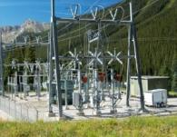



We automate, upgrade, and transform power grids
Distribution substation automation
Feeder
automation
Transmission
and complex substations
Underground
and overhead
self-healing grids
IEC 61850
engineering
services
Life cycle
services

Slide 25



Solutions for grid modernization
Distribution substation automation
Feeder automation
Monitoring and control system for distribution substations based on templates and open protocols for greater flexibility
Scalable, easy to customize, and smoothly integrated in the grid
Tested templates with embedded cyber security and redundancy for system reliability
Stand-alone system based on reclosers, sectionalizers, and controllers that detect and react to upstream and downstream events
Fault location, isolation, and service restoration reduce outage duration and number of affected customers
The number of operator interventions and field crew dispatches is reduced

Slide 26


Solutions for grid modernization
Transmission and complex substations
Underground and overhead self-healing grids
Systems designed for HV and MV substations, for network supervision, protection, automation, and control
Improve operational visibility and
energy availability
Compliant with IEC 61850 and IEC 62443 cyber security standards (Achilles Bronze certification)
Self-healing systems for isolating faults and restoring energy supply
Power is quickly restored for customers outside the affected area without operator intervention
Zones affected by outages are reduced and voltage dips are minimized

Slide 27
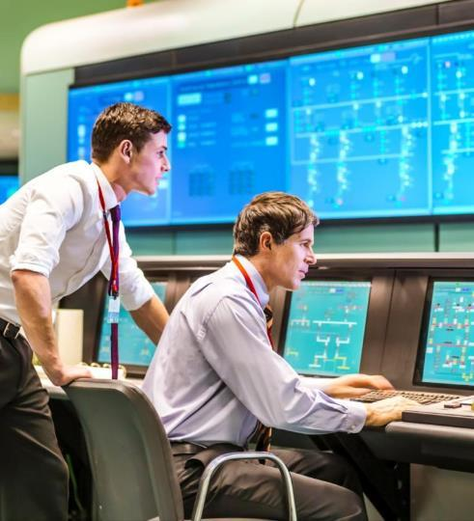
Solutions for asset management and operations
Cut outages and reduce maintenance costs by up to 30%* with a fully digitized asset portfolio and IT control systems
* Based on previous customer data..

Slide 28

Smart Grid -Electric network
GRID OF THINGS
Notes:
This is an example of a Title Slide. We need to convey Life Is On in everything we do, so try to lead with compelling images that are vibrant, authentic, and human. The human element should be apparent and within the context of a segment that we touch.
To keep this PowerPoint template file size reduced, we included a small library of image choices in the Slide Master (under View). You can also get them from the SE Asset Library: https://schneiderelectric.telescopeondemand.com

Slide 29
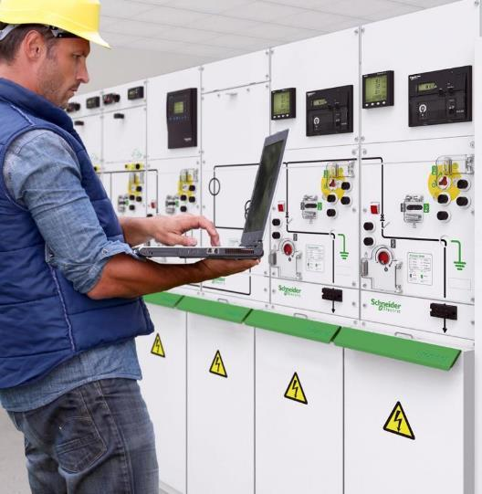

Smart equipment
for connected
"grid of things"
Improve assets visibility and
control by up to 30%* with connected devices
* Based on previous customer data. This is not a guarantee of future performance or performance in your particular circumstances.

Slide 30



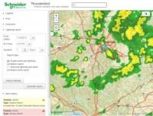
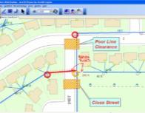
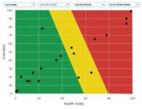
We leverage energy data for improved operations
Distribution
SCADA
Advanced Distribution Management
System
Outage
Management
System
Weather
Intelligence
Geospatial Information
System
Asset
Performance Management

Slide 31





We deliver IoT-ready, connected devices
Smart Grid Switchgear - Premset
Easergy T300
Feeder RTU
Minera SGrid Controllable Transformer
LV Monitoring Module and
Sensors

Slide 32
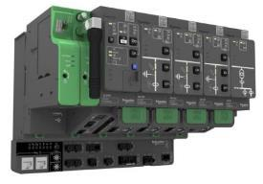
Smart equipment for connected "grid of things"
Easergy T300 Feeder RTU
Powerful and flexible feeder automation devices for managing bidirectional and intermittent power flows
Easergy T300 helps increase grid availability by reducing duration of LV outages through automatic reconfiguration
Power quality is maintained with accurate MV and LV voltage measurement
Modularity and remote asset management optimize installation, operation, and maintenance costs
Network efficiency is improved through reduced technical and non-technical losses
Product photo
Easergy T300 Feeder RTU

Slide 33
Smart Grid
REFERENCES

Slide 34
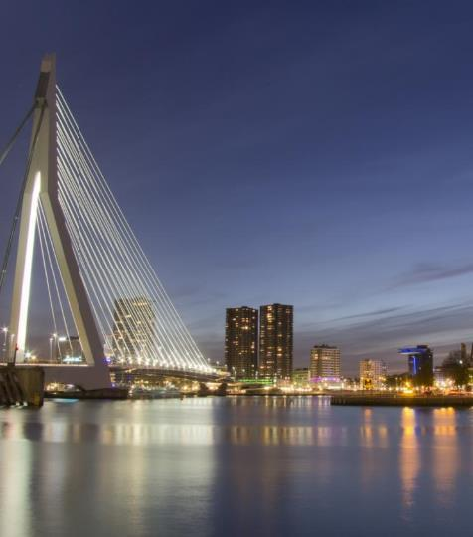
Stedin, Rotterdam
Automatic rapid response to power failure
  Customer need
  Compliance with strict reliability regulations or costly penalties
  Improve network operations to avoid disturbances
  Schneider Electric solution
  A self-healing grid based on motorizing existing Ring Main Units and peer-to-peer communication in downtown Rotterdam
  Benefits
  Targeted sections of the distribution network automatically re-energize when faults occur
  Fault are quickly localized through simple peer-to-peer communication between substations
    Results
  When a blackout occurred in January 2015, the network was re-energized in 18 seconds rather than an average two hours

Slide 35
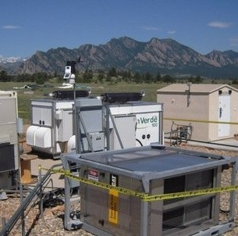
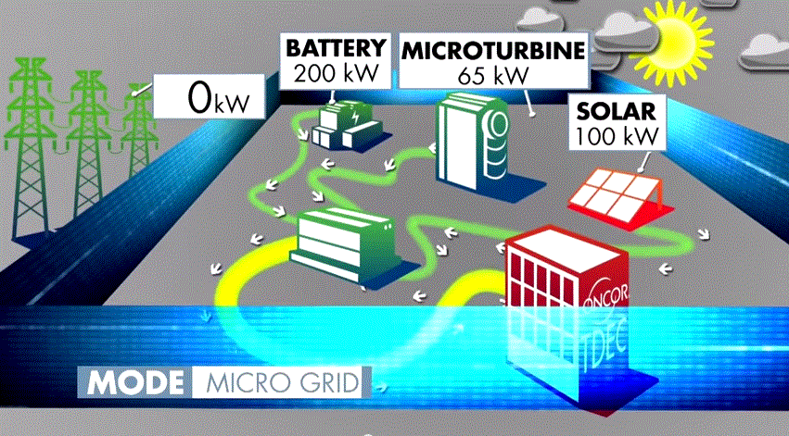
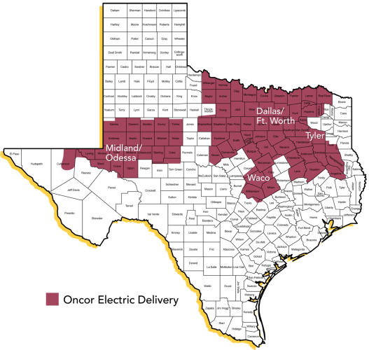
Oncor Electric Delivery
Texas, USA
Innovative microgrid improves utility’s reliability
and optimizes distributed energy resources
Customer Challenge
Ensure uninterrupted delivery of power for its millions of customers
Diversify it’s energy generation assets using a mix of utility supply and renewables
Boost grid capacity and reliability
The Solution
PowerLogic™ Microgrid
StruxureWare™ Demand-Side (Controllers)
StruxureWare™ PowerSCADA Expert and system engineering (Operation)
S&C Electric IntelliRupter® Pulse Closer and Scada-Mate™ CX Switches and Vista®
Underground Distribution Switchgear
Customer Benefits
Optimizes distributed energy resources
Delivers a dynamic, flexible microgrid technology
Determines when it’s best to buy, sell or store power automatically
Provides a technology showcase
When leaders in three industries – public utilities, energy management
and power delivery – teamed up, they delivered one of the most advanced microgrid solutions in the country
in record time.
Notes:
Additional Information:
http://microgrids.schneider-electric.us/wp-content/uploads/Oncor-case-study-vF-4.13.15-2.pdf
https://www.youtube.com/watch?v=Hxr7ELpBcMs

Slide 36
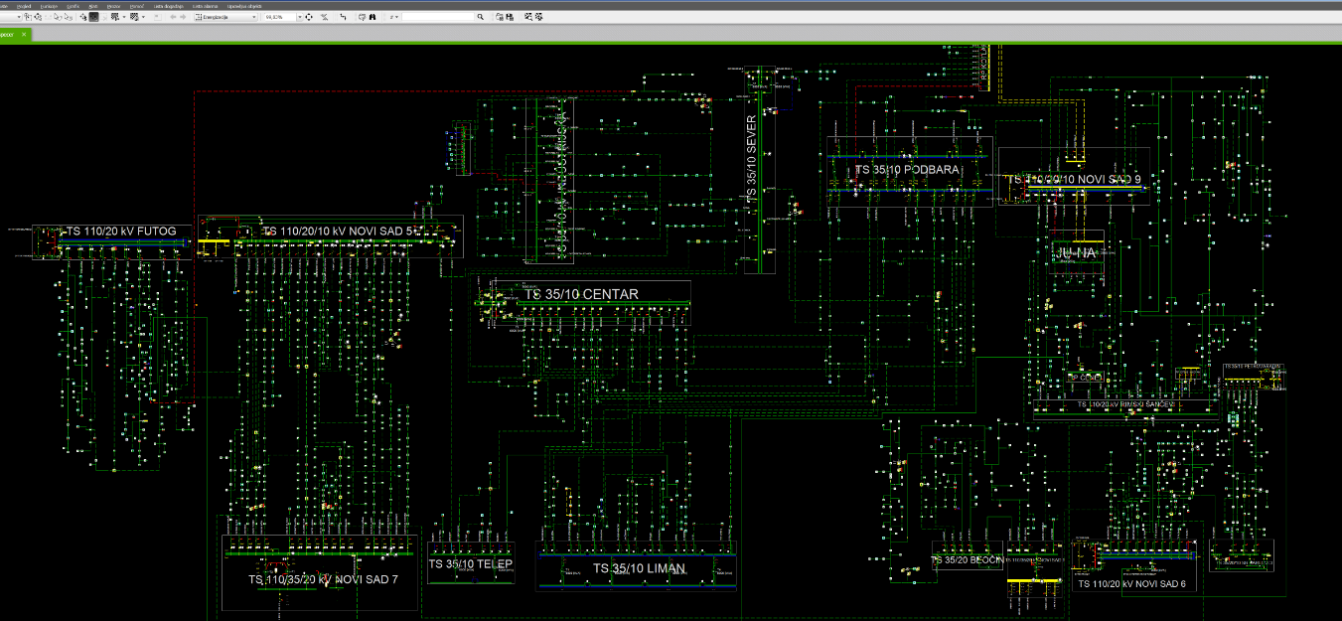
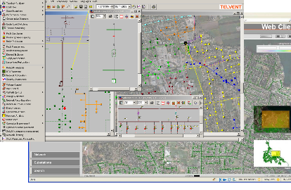
Smart City, Novi Sad
JP EPS, Elektrovojvodina
  Customer need
  Integration of Operation technologies in Control Center
  Improve network operations to avoid disturbances
  Schneider Electric solution
  A full scope feeder automation grid based on motorizing existing Ring Main Units and digital communication in Novi Sad area.
  ADMS solution in Control Center – unified HV and MV SCADA
  Benefits
  Targeted sections of the distribution network automatically re-energize when faults occur
  Fault are quickly localized through remote signalization communication
    Results
  Cost benefit analize proved succesfull
  SAIDI and SAIFI lowered – customer satisfaction
  Best project award 2017 – Drustvo informaticara Srbije -PKS

Slide 37
SAIDI (System Average Interruption Duration Index)
SAIFI (System Average Interruption Frequency index)
CAIDI (Customer Average Interruption Duration Index)
R. br.F-03
 | SAIDI (min/user) |  |  | SAIFI outage/user) |  |  | CAIDI (min/outage)
 | Unplanned | Planned | Total | Unplanned | Planned | Total | Unplanned | Planned | Total
2009 | 206.72 | 364.98 | 571.71 | 3.57 | 2.27 | 5.84 | 57.83 | 161.02 | 97.88
2010 | 298.65 | 350.91 | 649.55 | 4.98 | 2.03 | 7.01 | 60.02 | 172.80 | 92.71
2011 | 144.33 | 316.20 | 460.52 | 2.61 | 1.86 | 4.47 | 55.35 | 169.95 | 103.07
2012 | 181.30 | 390.56 | 571.86 | 3.22 | 2.28 | 5.50 | 56.39 | 171.29 | 104.07
2013 | 174.75 | 414.69 | 589.44 | 2.78 | 2.37 | 5.16 | 62.82 | 174.72 | 114.34
2014 | 218.20 | 382.02 | 600.22 | 3.47 | 2.34 | 5.81 | 62.83 | 163.52 | 103.33
2015 | 95.82 | 405.86 | 501.67 | 1.82 | 2.02 | 3.85 | 52.63 | 200.48 | 130.47
52 .20% 49.02% 8.99%
 | Undelivered energy (MWh) |  |  | Average undelivered energy (kWh/user) |  |  | Average outage duration (min/outage)
 | Unplanned | Planned | Total | Unplanned | Planned | Total | Unplanned | Planned | Total
2009 | 1506 | 2107 | 3613 | 5.73 | 8.01 | 13.74 | 130 | 138 | 136
2010 | 1509 | 1776 | 3285 | 5.59 | 6.58 | 12.18 | 125 | 148 | 139
2011 | 643 | 1494 | 2137 | 2.34 | 5.44 | 7.78 | 122 | 134 | 130
2012 | 821 | 1632 | 2453 | 2.95 | 5.86 | 8.81 | 115 | 133 | 127
2013 | 736 | 1571 | 2307 | 2.62 | 5.59 | 8.20 | 137 | 155 | 151
2014 | 932 | 1687 | 2619 | 3.28 | 5.94 | 9.22 | 178 | 141 | 152
2015 | 470 | 1548 | 2018 | 1.67 | 5.51 | 7.18 | 106 | 174 | 154
68.79% 82.55% 18.46%

Slide 38
Using of ADMS in incidents – example 1
25.03.2016. u 8:57h u TS 110/20kV Futog
Outage of TR2 Io> in Transformer bay
Outage of P = 14,85MW
Customers in outage 13.116
ADMS restoration scenario:
„T-20/35 kV“ 4442 users 5.76 MW 12 min
„Veternik “ 2565 users 2.67 MW 26 min
„Rumenka “ 2294 users 2.17 MW 27 min
„Veternik 2“ 3815 users 4.25 MW 34 min

