Slide 1
SERBIAN ELECTRICITY MARKET
AND SUSTAINABILITY OF SUPPLY
Dragan Vlaisavljevic PE EPS
December 2016

Slide 2

There | is | no | single | story | about | the | future
of | global | energy;
policies
will
determine
where we
go
from here
Key points of orientation:
Ø Middle East share in global oil production in 2016 at highest level for 40 years
Ø Transformation in gas markets deepening with a 30%
rise in LNG
Ø Additions of renewable capacity in the power sector
higher in 2015 than coal, gas, oil and nuclear combined
Ø Energy sector in the spotlight as the Paris Agreement enters into force
Ø Billions remain without basic energy services
•

Slide 3
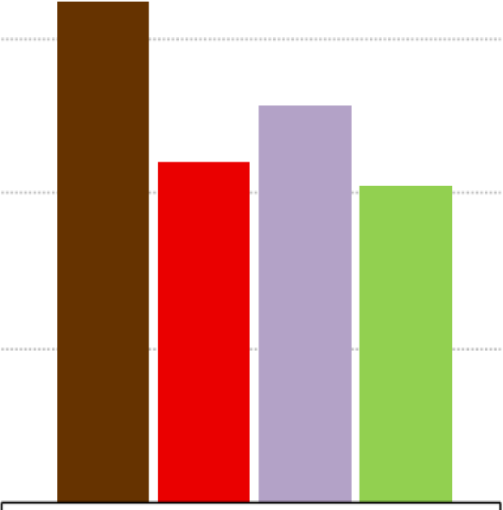
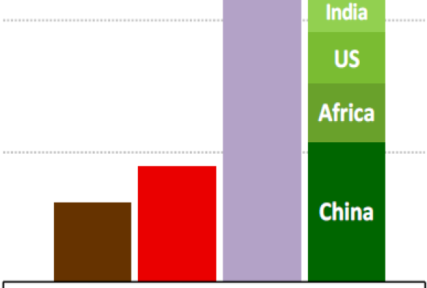
Change in total primary energy demand
1990-2015 2015-2040
(lJ 2 000
0
+-'
2
Rest of
world
1500
European Union Latin America
1000
500
Coal
Oil
Gas Low-
carbon
Coal Oil
Gas Low-
carbon
Low-carbon fuels & technologies, mostly renewables, supply nearly half of the increase in energy demand to 2040

Slide 4
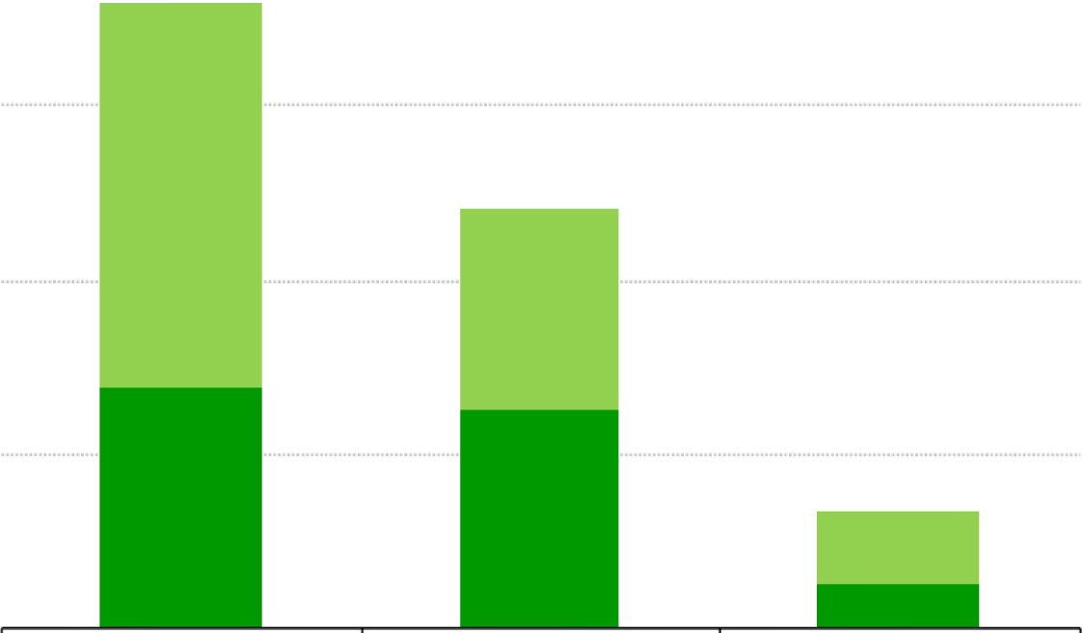
Renewable energy use by sector
Mtoe
1200
900
•Addit ional
600
to 2040
• 2015
300
Electricity Heat Transport
Today renewables in electricity and heat use are nearly at par; by 2040, the largest untapped potential lies in heat and transpor t

Slide 5


Net oil imports
United States
European Union
China
India
"O 20
.........
..0
E
I
Net oil imports
15
Reduction in net oil imports due to:
Switch to electric and naturalgas vehicles
:I. Switch to renewables Efficiency improvements
10
5
Z Increase in oil production
2014-2040
2014
2040
2014 2040
2014 2040
2014
2040
The energy transition provides instruments to address traditional energy security concerns, while shif ting attention to electricity supply

Slide 6
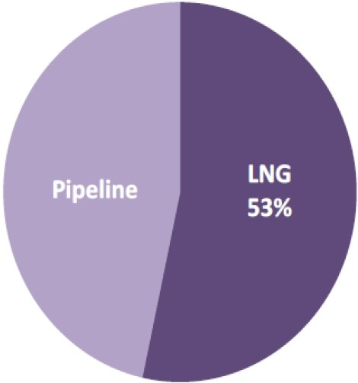
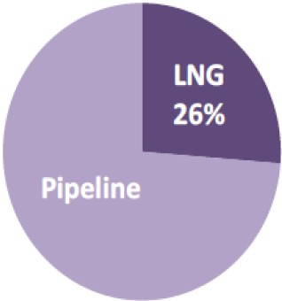
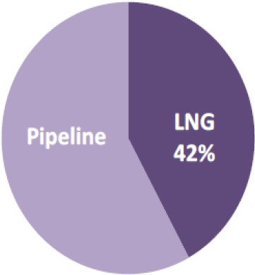
Share of LNG in global long-distance gas trade
2000
525 bcm
2014
685 bcm
2040
1150 bcm
Contractual terms and pricing arrangements are all being tested as new LNGfrom Australia, the US & others collides into an already well-supplied market

Slide 7
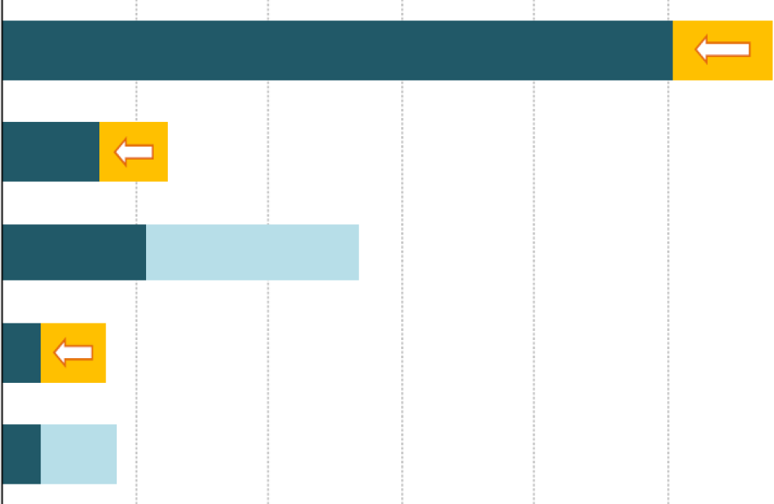
Coal demand in key regions
China
United States
Change 2014-2040: Decreasing demand Increasing demand
India
European Union
Southeast Asia
500
1000
1500
2 000
2 500
3 000
Mtce
The peak in Chinese demand is an inflexion point for coal; held back by concerns over air pollution & carbon emissions, global coal use is overtaken by gas in the 2030s

Slide 8
MARKET LIBERALIZATION
WHY (AMONG OTHER THINGS) DO COUNTRIES INTODUCE LIBERALIZATION?
MATURE ECONOMIES: DEAL WITH OVERINVESTMENT
DEVELOPING ECONOMIES: DEAL WITH UNDERINVESTMENT
CAPACITY MARGIN = (INSTALLED GENERATION CAPACITY – PEAK LOAD) / PEAK LOAD

Slide 9
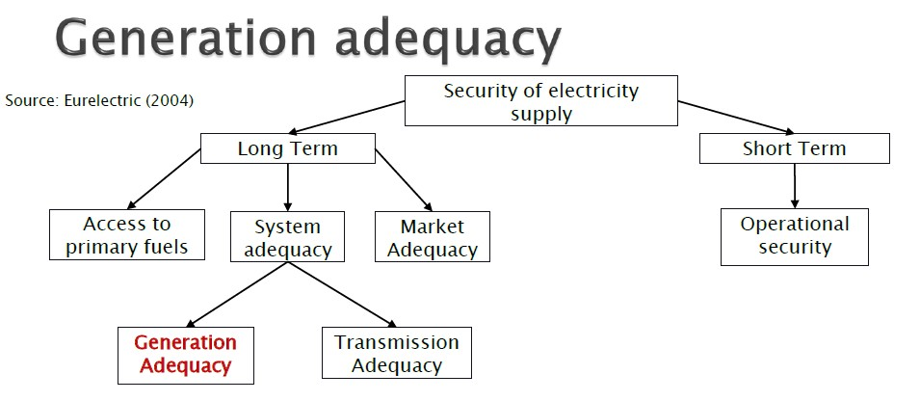
GENERATION ADEQUACY IN A MARKET ENVIROMENT
GENERATION ADEQUACY -> MEET DEMAND ON LONGER TIME-SCALE BASIS

Slide 10
Guiding principles translate into clear policy
requirements for the power system of tomorrow
TO ACHIEVE:
A market design and regulatory conditions that ensure sufficient generation and infrastructure investments
WE ASK FOR:
A market design that properly values energy, flexibility and capacity
Promotion of security of supply through energy
sources diversification

Slide 11
Integration with neighboring
regions/markets
A SEE wholesale market coupled to other European power markets is expected to deliver less volatility to market prices, improve market liquidity, and enable more efficient use of existing cross- border capacity, while establishing a reliable and trustworthy price reference for the region and enhancing confidence of investors.
This is an ambitious objective taking into consideration current status of electricity markets in the region, but also a must for countries that are in various stages of EU accession procedure.

Slide 12
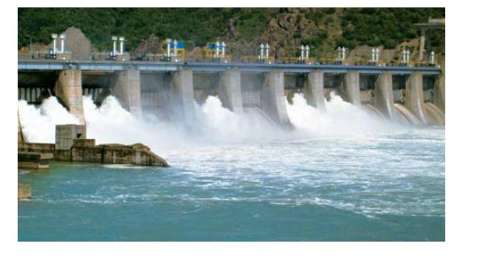
THANK YOU
dragan.vlaisavljevic@eps.rs

