Slide 1
MASTERPLAN For LNG on Rhine-Main-Danube Axis
BUILDING A PIONEER MARKET AND LNG ARTERY FOR EUROPE
Energy Future of the Balkans,
Belgrade, 7 April 2016
Žaneta Ostojić Barjaktarević Manfred Seitz
Senior Adviser Project Coordinator

Slide 2
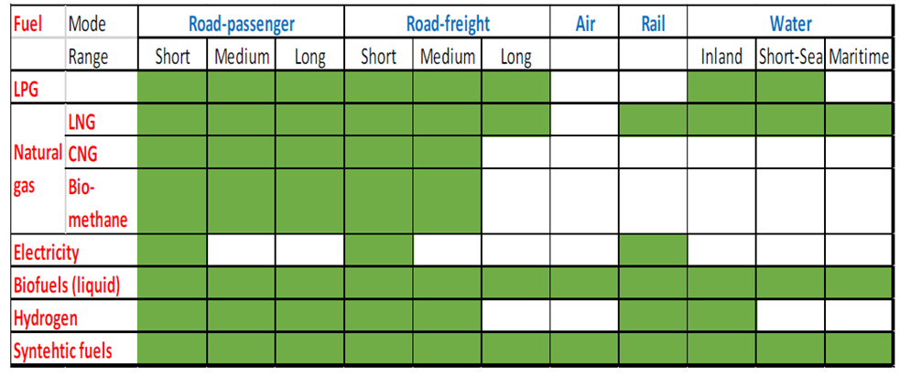
EU energy & transport policy
Clean Power for Transport: A European alternative fuels strategy
(COM(2013) 17 final)
Europe is heavily dependent on imported oil for its mobility and transport: in 2010, oil counted for 94% of energy consumed in transport
A strategy for the transport sector to gradually replace oil with alternative fuels and build up the necessary infrastructure could bring savings on the oil import bill of € 4.2 billion per year in 2020
Low-CO2 alternatives to oil are also indispensable for a gradual decarbonisation of transport, a key objective of the Europe 2020 strategy for smart, sustainable and inclusive growth
A coherent and stable overarching strategy with an investment -friendly regulatory framework needs to be put in place
Energy Future of the Balkans, 7 Apr 2016

Slide 3
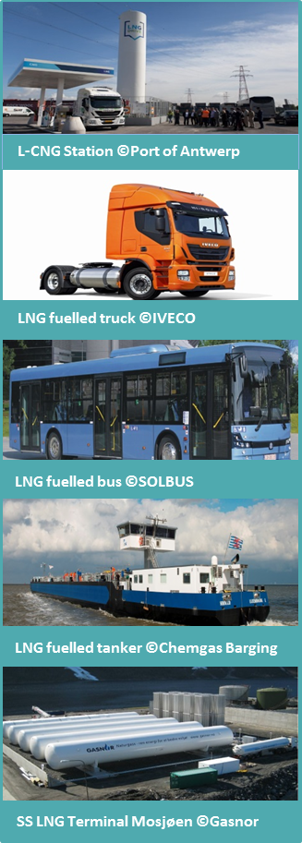
Properties of LNG
LNG is natural gas cooled down to minus 162 °C; making it extremely compact: 3.5 times more compressed than CNG and 600 times more compact than natural gas
LNG consists largely of CH4-methane (> 90%) and for the rest of ethane, propane, butane and nitrogen, often mistaken for liquefied petroleum gas (LPG) which is a mixture of mainly propane and butane, liquid at environment temperature and moderate pressure (<1.5MPa)
CO2 emission of fossil LNG compared to diesel is around 15% less, bio-LNG becomes improves CO2 performance significantly
Safety: LNG is a cryogenic substance: it is lighter than air, colorless, odorless, non-toxic, non-corrosive and non-flammable. Methane/air mixture only flammable in range of 5-15%
Energy Future of the Balkans, 7 Apr 2016

Slide 4
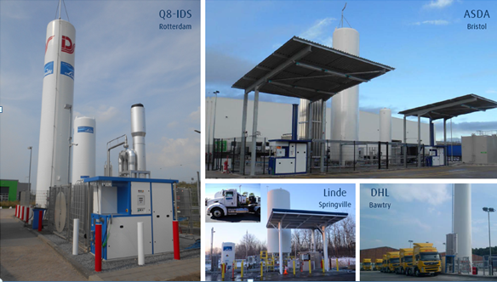
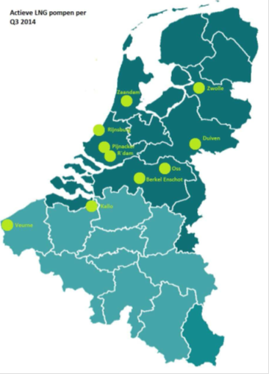
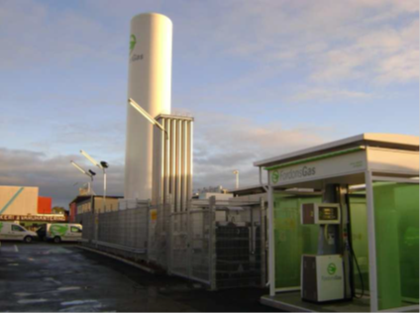
CNG & LNG in TRANSPORT & Bio-methane
In EU 1.200.000 CNG vehicles (0.7% of EU vehicle fleet); industry aims to 5% of fleet by 2020
3.000 CNG refuelling stations, majority in DE & IT
15 million vehicles worldwide; strongest growth in Asia & South America
Several hundreds EURO V & EURO VI LNG trucks & c100 LNG/L-CNG stations (UK, E, SE, NL)
China: 240,000 LNG trucks & c.2,500 refuelling stations; USA: >25,000 LNG trucks
In 2013 bio-methane produced in 14 European countries (230 upgrading plants), total capacity of 0,8 billion m3/year; grid injection in 11 European states
over 300 CBG100 and 100 LBG stations in AT, CH, DE, DK, FI, FR, HU, IS, IT, NL, SE, UK
blend of 85% LNG and 15% BLG results into minus 35% CO2 (UK example)
Goteborg L-CNG station
Linde LNG truck fuelling stations
Energy Future of the Balkans, 7 Apr 2016

Slide 5
Rationale for LNG in IWT
Environmental drivers
LNG as fuel reduces air emissions (-10-20% CO2, -80-90% NOx, almost zero PM & SOx)
Further CO2 reduction possible by “blending” (balance) with BIO-LNG
Economic drivers
Price gap Gasoil - LNG and estimated price reduction for LNG due to massive production increase; favourable payback time of investment; significant reduction in fuel consumption; fuel cost savings result into higher profitability/lower transport costs
LNG as cargo will increase transport volumes and will offer energy cost savings to many industries along the Rhine-Main-Danube axis; reduces oil dependency and supports diversification of energy mix
Regulations
EU Directive on Deployment of Alternative Fuels Infrastructure (approved April 2014) demands deployment of LNG fuelling infrastructure (in a sufficient number of maritime ports till 2025, inland ports till 2025, core road network till 2025 & common technical standards for CNG and LNG refuelling points by 2015
Future air emission regulation: “LNG most effective measure to reach Stage IV for medium and large inland vessels” (NAIADES 2/Panteia-NEA report)
ECA/SECA regulation which fosters built-up of LNG infrastructure in NW-Europe and development of Small Scale LNG Supply Chains
Energy Future of the Balkans, 7 Apr 2016

Slide 6
MISSION & OBJECTIVES
MISSION
To facilitate the deployment of LNG as an eco-friendly alternative fuel and a new commodity for the inland navigation sector.
OBJECTIVES
1. Based on the input and recommendations from various project activities to elaborate strategy – action plan with measures – for LNG deployment in IWT 2. to test, operate and monitor LNG deployment pilots
FRAMEWORK, MARKETS & FINANCES
VESSEL CONCEPTS
ENGINES & TECHNOLOGIES
TERMINAL CONCEPTS
MASTERPLAN
Strategy for LNG deployment in IWT
SAFETY & OPERATIONAL ASPECTS
EDUCATION & TRATINING
REGULATORY FRAMEWORK
PILOT DEPLOYMENTS

Slide 7
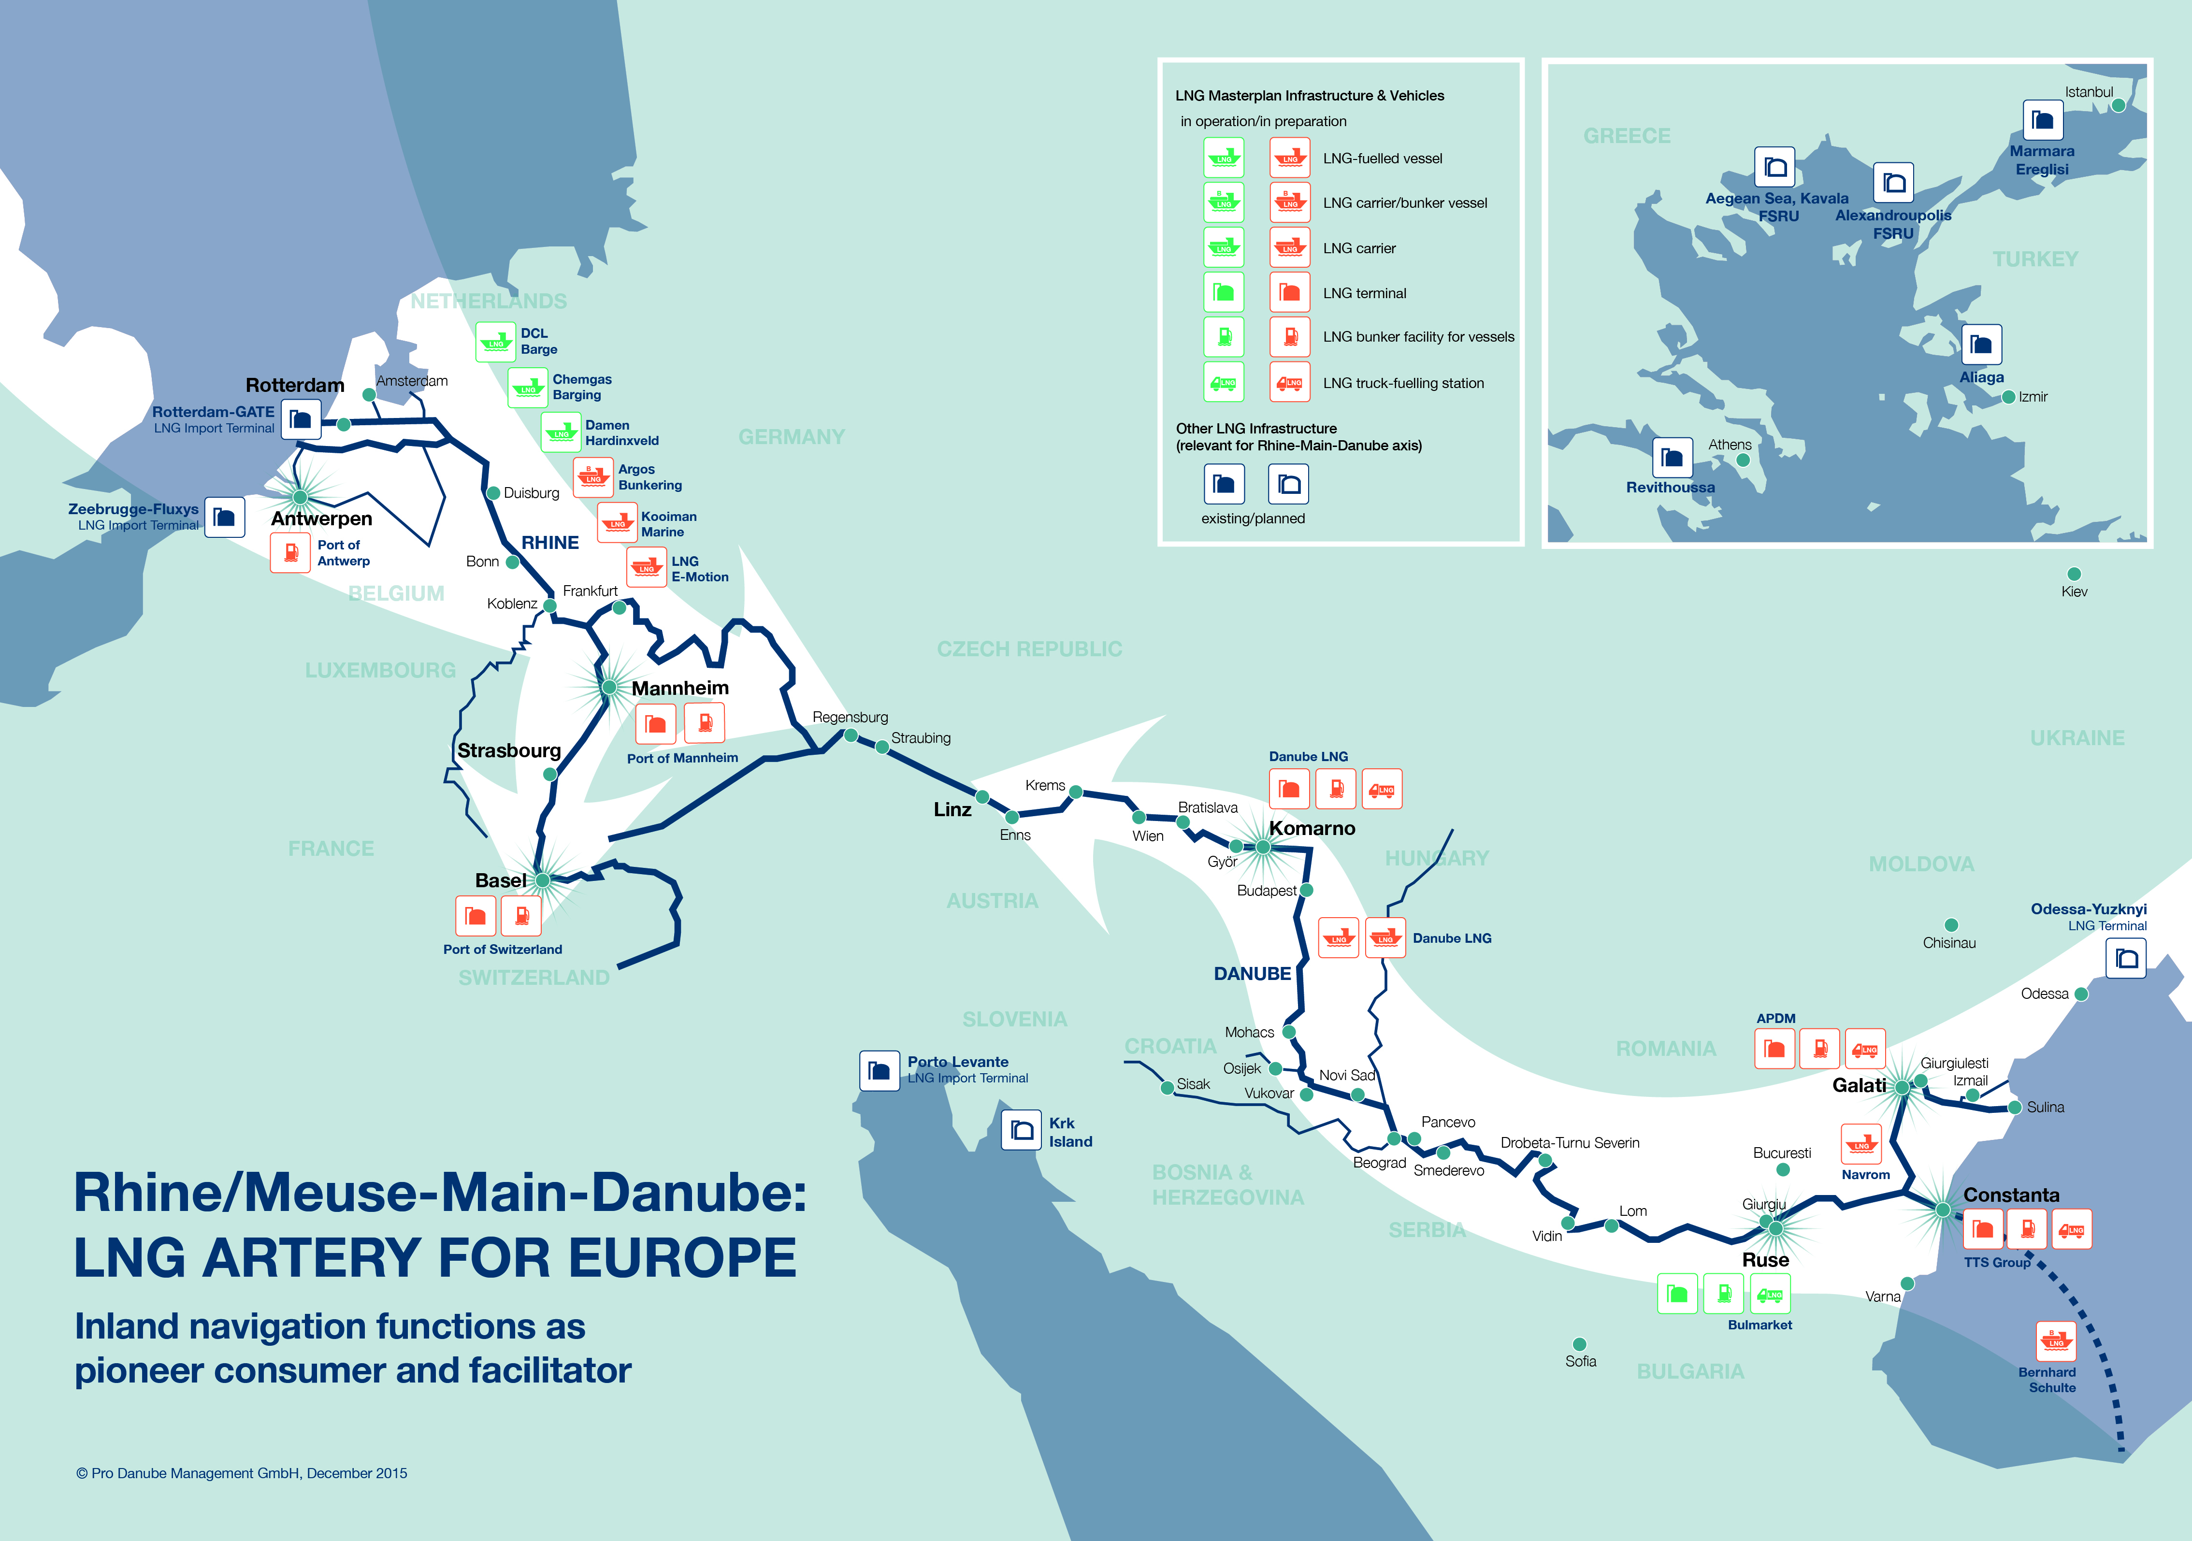
FRAMEWORK & MARKET Studies
FRAMEWORK & MARKET STUDIES
RHINE REGION
Several LNG sourcing options available. Demand in Lower Rhine dominated by maritime sector & in Upper Rhine by IWT, trucks and industry
DANUBE REGION
Several sourcing options were investigated (North-West Europe, the Black Sea / Eastern Mediterranean or Caspian region. Demand is dominated by LNG as alternative energy source for industry – especially in countries with less developed gas transmission network (Bulgaria) and transport.
IMPACT ANALYSIS
Investigating general safety aspects, impact on ecology & socio-economic aspects

Slide 8
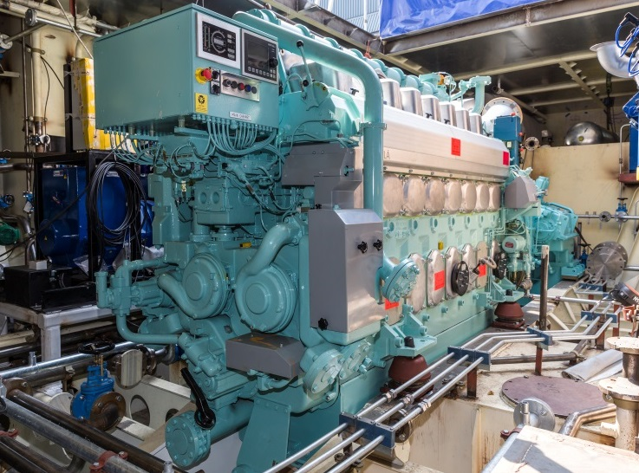
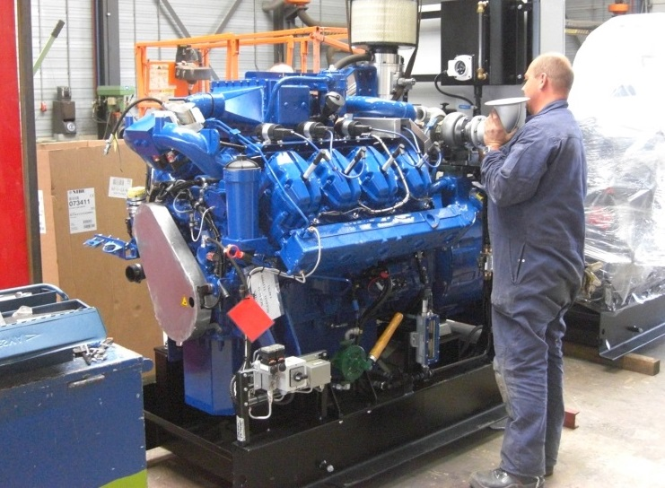
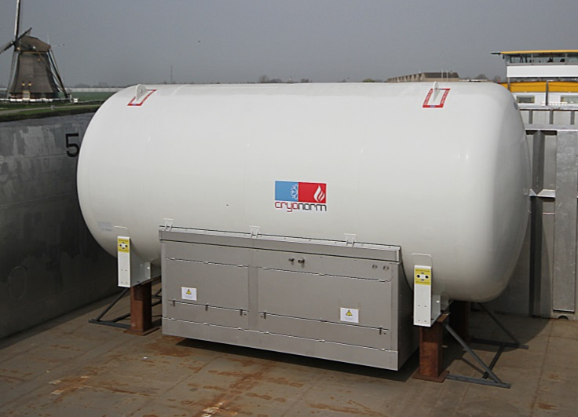
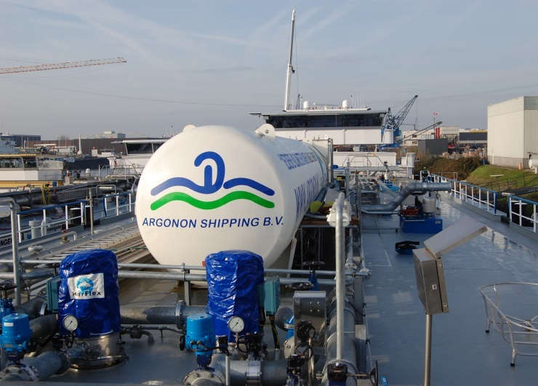
ENGINES, TANKS & LNG RELATED TECHNOLOGIES
ENGINES, TANKS & LNG RELATED TECHNOLOGIES
ENGINES
The Study discusses different engine types available for inland navigation. Load distribution, redundancy, exhaust and GHG emissions are considered. For use as auxiliary machinery, alternative engines, e.g. micro turbines and fuel cells, are discussed, too.
TANKS
The Study provides an overview of different LNG tank systems, described the thermodynamic background and the behaviours of LNG in a closed system. An improved understanding why tank technology is of importance for implementation of LNG as fuel is provide to the reader.
Wärtsilä 8L20DF dual-fuel engine © Chemgas
Scania SGI-16M gas engine © Damen
© DCL Barge B.V.
© Deen Shipping

Slide 9
FINANCES
FINANCES
TOTAL COST OF OWNERSHIP MODEL
To support the decision process for the conversion of inland vessels, the Total Cost of Ownership (TCO) model was elaborated. It addresses private funding (business case) as well as public funding (economic & social effects) and compares TCO of a LNG dual-fuel refit with conventional gasoil operation.
FINANCING OF INFRASTRUCTURE
Erste Group Bank investigated from a commercial key factors on which lenders will focus when evaluating financing opportunities of LNG structures and drafted a set of guidelines and recommendations for such projects.
REGULATORY, LEGAL & CONTRACTUAL IMPACT ON LNG SUPPLY CHAIN
The study done by Schönherr, a law firm, assists project partners in identifying legal difficulties of their concepts and provides guidelines how to diminish them.

Slide 10
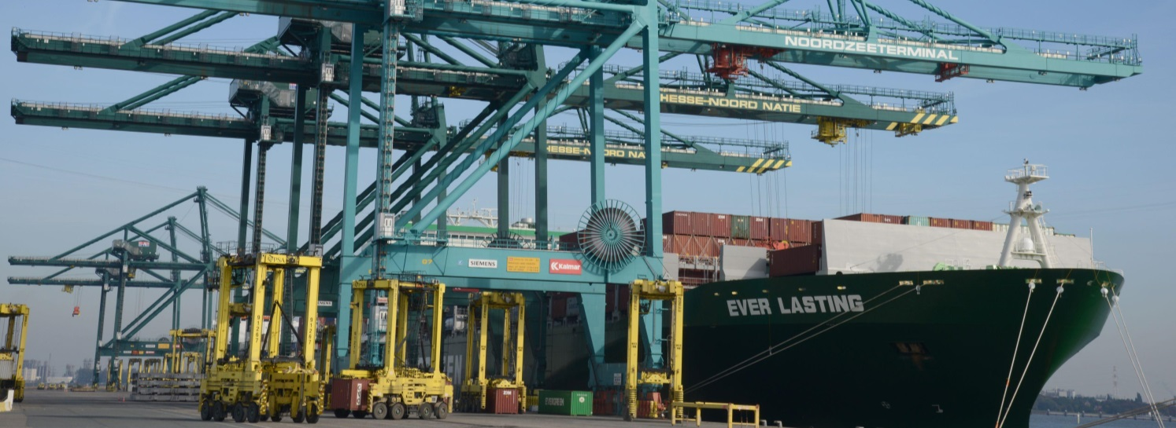
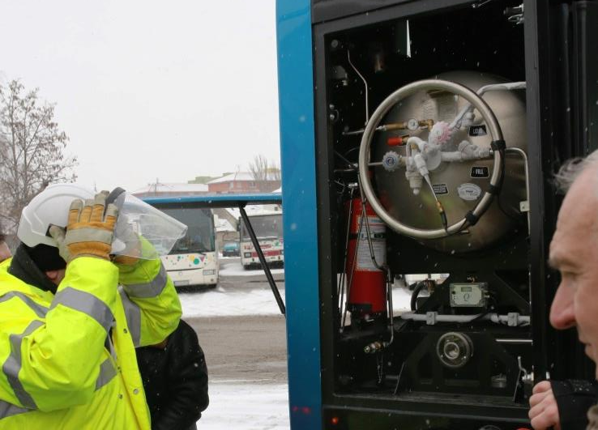
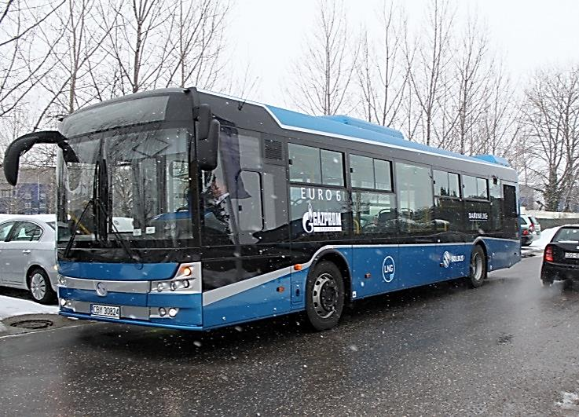
End-users: Road vehicles & port equipment
END-USERS
In its findings the LNG Masterplan project concludes that in order to create a viable business case the LNG inland terminals shall function as satellites for hinterland ensuring that LNG reaches its end-users like the public or heavy duty transport sector or industry stakeholders
LNG FOR ROAD TRANSPORT
The trials with public buses showed that use of LNG in transport contributes much to emission savings. Having travelled 5,108 km in Slovakia, 43.58 kg of NOx, 1.47 kg of PM and 0.04 kg
of SO2 were saved.
PORT EQUIPMENT
Port of Antwerp analysed the technical, economic and ecological aspects of drive train mechanisms for port equipment in the port of Antwerp.
Investigated alternatives: stage IV diesel engines, CNG, LNG and electric TCO of gas turbine LNG-driven straddle carrier is likely to be significantly lower as compared to diesel hybrid.
© Port of Antwerp
LNG-fuelled bus ‘Solbus’© Danube LNG
© Danube LNG
© Deen Shipping

Slide 11
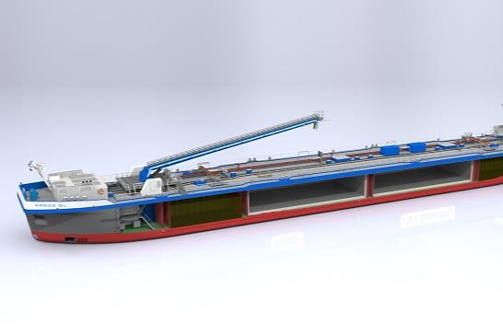
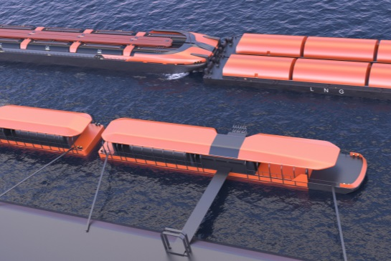
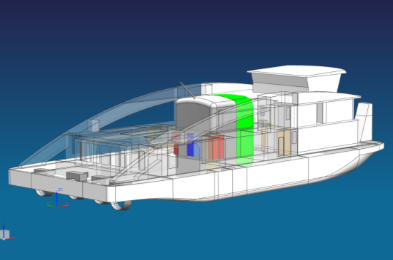
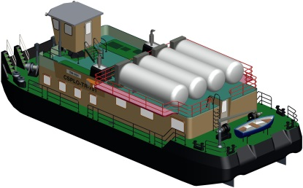
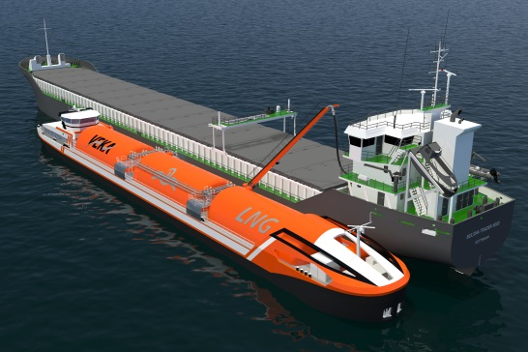
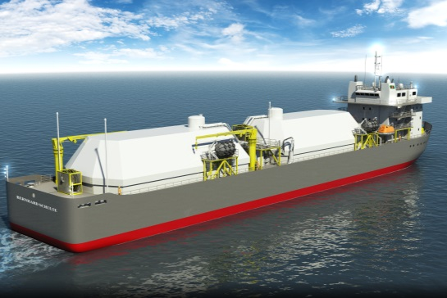
VESSEL CONCEPTS
LNG/Gasoil bunker vessel
Size: 110 m x 13.5 m (L x W)
Propulsion: 3 x gas generators and 1 diesel generator (backup)
Tanks: 4 x 380 m³ of gasoil, 2 x 935 m³ of LNG in membrane tanks (GTT Mark III Flex membrane system)
LNG Danube river-sea tanker & river barge
Size: 130 x 16.6 m (L x W). Draught (min): 1.6 m
Propulsion: dual-fuel (using boil-off)
Tanks (cargo): 10 x 348.5 m³ of LNG
Barge tanks (cargo): 3 x 348.5 m³ or 6 x 348.5 m³.
LNG/Gasoil bunker vessel © Argos Bunkering B.V.
LNG river-sea tanker with barges © Danube LNG
LNG fuelled push boat © Kooiman Marine B.V.
LNG-fuelled push boat
Size: 40 x 18 m (L x W). Draught: 1.6 m
Propulsion: 4 x 1,060 kW Wärtsilä 6L20DF
Bunker capacity: 165 m³ (gross) of LNG & 80 m³ of gasoil
LNG tank: double-shelled vacuum insulated type C (vertical design)
Retrofit solution © Danube LNG
RETROFITTING
Dual-fuel propulsion with vacuum-insulated LNG tanks with a capacity of 2 x 49 m³ for the type TR 1000 and of 4 x 6.75 m³ for the type TR Muflon 1100 is considered as a viable option.
LNG-fuelled push boat
Size: 40 x 18 m (L x W). Draught: 1.6 m
Propulsion: 4 x 1,060 kW Wärtsilä 6L20DF
Bunker capacity: 165 m³ (gross) of LNG & 80 m³ of gasoil
LNG tank: double-shelled vacuum insulated type C (vertical design)
LNG-fuelled gas supply ship
Size: 110x18m (LxW). Draught: 5.3m
Propulsion: 4 x Wärtsilä DF generators (use of boil-off gas, stored as CNG, to supply the gas engine)
LNG tank: range from 3,500 m³ to 13,000 m³
LNG inland tanker © LNG E-motion B.V.
LNG-fuelled gas supply vessel © Bernhard Schulte, BMT TITRON

Slide 12
Terminal concepts
TERMINAL CONCEPTS
RHINE REGION
LNG bunker station in Port of Antwerp
LNG infrastructure in Port of Mannheim
LNG infrastructure in Port of Switzerland
DANUBE REGION
LNG small scale terminal in Constanta (RO)
LNG small scale terminal in Galati (RO)
LNG small scale terminal in Ruse (BG)
LNG floating terminal in Komarno (SK)

Slide 13
MASTERPLAN
Provide air emission limits in line with technological development, implement / create regulatory framework for LNG as fuel / cargo, provide guidelines for mobile LNG fuel tanks, provide guidelines for harmonised port regulations, spatial planning, risk assessment, LNG bunker stations & vessels, ensure safe & efficient LNG bunkering & (un-)loading
Facilitate sufficient LNG fuelling infrastructure (enforcement of DAFI, provision of adequate locations, efficient & fast permitting procedure, incl. environmental) , provide infrastructure for intermodal LNG logistics
82 MEASURES
33 ACTIONS
INFRASTRUCTURE
GOVERNANCE & LEGISLATION
AWARENESS
MARKETS & FINANCING
Increase awareness on socio-economic benefits of LNG, inform on safety requirements and standards for LNG infra-structure & operations, ensure implementation of Action Plan
Provide user oriented information, ensure fair & sustainable competition in LNG market, create economies of scales, provide public support for vessel operators & for LNG infrastructure build-up and extension
6 THEMES
VESSELS & EQUIPMENT
JOBS & SKILLS
Provide regulatory framework together with competencies required in handling of LNG for various personnel, facilitate EU-wide acceptance of E&T related to LNG, improve availability of and access to E&T, improve quality of LNG-related education through dedicated learning tools, ensure recognition & certification of E&T institutes, endure capacity of emergency responses
Minimise methane slip of engine & along LNG supply chain, facilitate production & use of advanced gas engines, manage boil-off on inland vessels, reduce bunkering time to comparable values with traditional fuels, facilitate retrofitting of vessels, reduce unit costs of LNG equipment, initiate continuous research on required safety levels for LNG equipment & operations

Slide 14
Implementation of LNG Masterplan - four mayor Instruments Proposed
Coordination of Implementation
LNG Action Plan (Governance & Technical Measures)
Awareness & Promotion Campaign of LNG Platforms plus
Market Sides Measures
Program Support Action (PSA) 2016-2018
Interreg Europe /PSA 2016-2018
IWT Lead Project for LNG innovations
Deployment Projects
Horizon 2020 Open Call /Call 2017
CEF Pilot Projects National Programs Interreg Program
EFSI Blending

Slide 15
RECOMMENDATIONS for policy makers in Danube Region
Develop and implement a National Strategy for Alternative Fuel with LNG as key element (like many other EU States are currently doing)
Take preparatory steps to LNG fueling infrastructure parallel to EU Directive on Deployment of Alternative Fuels Infrastructure (DAFI)
Stimulate engagement and commitment of public administrations to develop public-private partnership structures to optimize EU funding
Engage in EU activities for regulatory framework of LNG as fuel (technical provisions for vehicles, standardization and harmonization of fueling, storage, safety, etc. regulations and administrative procedures)
1
2
3
4
5
6
7
8
Set-up a National Platform for LNG to unite public and private stakeholders for innovation and deployment projects (following the Dutch model)
Stimulate investment in LNG fueling infrastructure as well as in LNG-fueled vehicles operated by public organizations (e.g. public transit & public utility operators) and make use of EU Programs 2014-2020
Secure LNG supply as part of national economic, transport & energy strategies
Use national potentials and foreign policy to overcome supply problems in start up phase

Slide 16
Thank you for your attention
Žaneta Ostojić Barjaktarević
Senior Adviser
Manfred SEITZ
Project Coordinator
Pro Danube Management GmbH
Handelskai 265
1020 Vienna, Austria
ostojic@prodanube.eu
seitz@prodanube.eu
www.lngmasterplan.eu
www.prodanube.eu
Energy Future of the Balkans,7 Apr 2016

