Slide 1
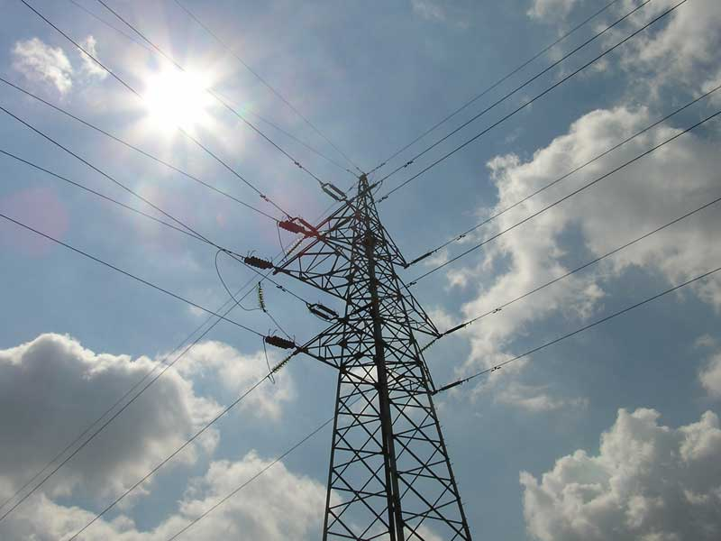

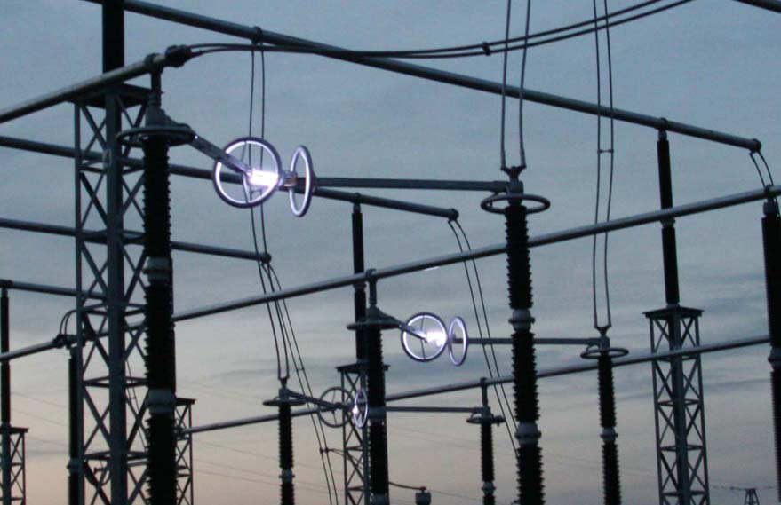
JP “Elektromreža Srbije” security reliability sustainability
Notes:
1

Slide 2
Agenda
Market roles of JP EMS
SEEPEX (South East European Power Exchange) project
Public Enterprise “Elektromreža Srbije”

Slide 3
JP EMS (TSMO) – Business Profile
Approximately 1370 employees, more than 350 with university degree
Core licensed activities:
- Transmission and System Operation (TSO)
- Organized Market Operation (NEMO)
Transmission operation – 400, 220 and part of 110kV network (installed power in EMS substations is about 19 500 MVA, HV Lines length 10.000km)
System Operation – two layers of grid control (National DC in Belgrade and Regional DC’s)
TSO market functions – Development and administration of the Serbian Electricity Market
Organized market operation – future spot market (Power Exchange)
Public Enterprise “Elektromreža Srbije”

Slide 4
Market functions of TSO since establishment in 2005
Scheduling operator (administration of bilateral or OTC market – schedules of BRPs) from 2005
Metering operator and aggregator (acquisition and validation of metering accounting data) - from 2005
Third party access to the transmission network (introduction of separated transmission tariff) - from 2008
Cross border capacity allocator (allocation, explicit auctions) - from 2005
Organization of balancing market (single buyer/seller of system and balancing services) – regulated from 2005, market from 2013
Administration of balance responsibility (BRPs) – for trading purposes only from 2005, for balance groups from 2013
Public Enterprise “Elektromreža Srbije”

Slide 5
Market functions of TSO since establishment in 2005
Imbalance settlement operator (single buyer/seller of imbalances) – for balance groups from 2013
Single buyer of transmission losses – regulated from 2005, market based from 2013
Issuing body for guarantees of origin for electricity produced from renewable sources - planned for end 2013 / beginning 2014
Operator of organized market (day ahead and intraday spot market – power exchange) – planned for end 2013 / beginning 2014
Price market coupling with neighbouring power exchanges – planned for 2014
Public Enterprise “Elektromreža Srbije”

Slide 6
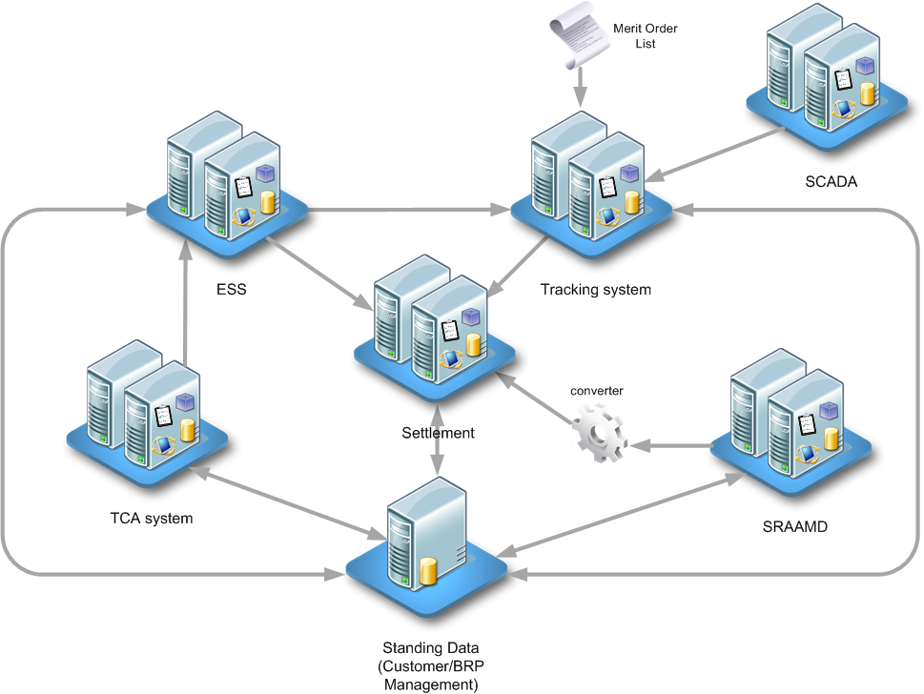
Business IT system in JP EMS - the latest ENTSO-E solutions in the field of System and Market Operation
Public Enterprise “Elektromreža Srbije”

Slide 7
Electricity Market development process in Serbia
Public Enterprise “Elektromreža Srbije”

Slide 8
2013.
Public
Supplier
Final consumers
(public supply)
Supplier
(in the free Market)
DSO
Privileged
Producers
(feed-in tariff)
Producers
EPS
Independent producer
EMS
Organized Market Operator
(NEMO)
TSO
+
Organizer of Bilateral and
Balancing Market
Neighbouring TSOs
Suppliers
in the free market
+ Backup supplier
Final consumers
(free market)
Legend:
Electricity flow
Commercial flows
The Plan
Notes:
Јавни снабдевач купује електричну енергију или природни гас на билатералном или организованом тржишту.

Slide 9
Electricity Market forced opening – starting from 01.01.2013.
Public supply: households and small customers – regulated prices
Supply in the market: market based, bilaterally negotiated supply contracts (with or without full supply)
Back up supply: up to 60 days; until 2015.
Public Enterprise “Elektromreža Srbije”

Slide 10
BRP status
From 01.01.2013. 26 consumers connected to transmission network lost right to public supply and are forced to find supplier on the free market.
They represent 9% of total consumption.
Until March 15th, 2013 28 market participants registered as Balance Responsible Parties (BRP)
  1 BRP as responsible party for production , consumption and trade
  1 BRP as responsible party for consumption and trade
  26 BRPs as responsible party for consumption and trade
From 01.01.2014. 4000 consumers connected to distribution network (medium voltage level) will lose right to public supply and will be forced to find supplier on the free market.
They represent 34% of total consumption.
From 01.01.2014. 43% of total consumption will be on the free market
Public Enterprise “Elektromreža Srbije”

Slide 11
Bilateral (OTC) market
Year | Export MWh | Import MWh | Internal exchange MWh
2012 | 10.780.678 | 10.768.602 | 7.815.100
2011 | 11.171.238 | 11.481.452 | 10.003.718
2010 | 10.551.039 | 11.581.564 | 5.835.769
2009 | 6.882.958 | 8.681.271 | 3.679.201
2008 | 7.077.221 | 7.203.887 | 2.045.423
Public Enterprise “Elektromreža Srbije”

Slide 12
Cross-border Capacity Allocation mechanism - 2013
Public Enterprise “Elektromreža Srbije”

Slide 13
Day-Ahead Market – SEEPEX project
Strategic partnership with regional TSOs (CG Prenos in initial stage), service providers (European PX’s), market makers (main regional production companies), IFI’s
OTC+ Power Exchange
OTC only
OTC + ongoing PX projects
Public Enterprise “Elektromreža Srbije”

Slide 14
SEEPEX Price Reference issue
For every hour on a day-ahead base
Volume
MWh
Electricity offered
MCV
Electricity Demand
MCP
Price
Public Enterprise “Elektromreža Srbije”

Slide 15
SEEPEX Day-ahead Market Model
Definition of the day-ahead products
  HOURLY PRODUCTS [1 … 24]
  BASE [1-24]
  PEAK [6-21]
  OFF-PEAK1 [1-5, 22-24]
  EURO-PEAK [9-20]
  EURO-OFF-PEAK1 [1-8, 21-24]
Auction phases’ timing to be determined in cooperation with market participants, possible outcome:
  Call Phase: open 14 days in advance, closing at 9:00
  Freeze Phase: 9:00 – 9:15 (time to call Mistrade)
  Price Determination Phase: (9:15 – 10:00)
Basic auction parameters
  Minimum deal 1 MWh
  Minimum price step in orders 0,10 €/MWh
  Price limits for orders
    Minimum price 0 €
    Maximum price 3000 €
  Fixing method:
    Closed auction, calculation of Market Clearing Prices & Market Clearing Volumes
  Market Coupling and Market Splitting may demand introduction of new parameters and/or other changes
Public Enterprise “Elektromreža Srbije”

Slide 16

SEEPEX Day-ahead Role Model
2) 9:15 (D-1) - Fixing
SEEPEX
Exchange
SEEPEX
Clearing
7) 15:00 (D+1) - Payment
3) 9:15-10:00 (D-1) - Results
1) Before 9:00 (D-1) -Bidding
5) 14:00 (D-1) - Financial statement
4) 11:30 (D-1) - Nominations
Bank
Members
EMS
System Operation
6) 00:00-24:00 (D) – Physical delivery
Public Enterprise “Elektromreža Srbije”

Slide 17
SEEPEX contribution to REM
SEEPEX will promote effective implicit allocation of cross-border capacity
With all relevant stakeholders (Regulators, TSOs, PX) and regional partners - involvement in the region-wide market coupling
Cooperation with Strategic Partners:
Development Stage I
Region-wide price formation - initially
multiple zonal price formation (perception
that congestion consists on all borders)
Transparent and non-discriminatory access
to the market, standardization of products etc.
Introduction of physical swap products – linking
isolated markets with standardised products
resulting in no cross-border transfers
Development Stage II
Market coupling – integrated regional price formation (expected uniform wholesale price index for more than 50% of the time)
Ensuring efficient use of interconnector capacity
RO
Implicit linking of multiple price indices by cross border capacities
Public Enterprise “Elektromreža Srbije”

Slide 18

SEEPEX Implicit Capacity Allocation
SEEPEX Implicit Allocation Focus
Public Enterprise “Elektromreža Srbije”

Slide 19
SEEPEX Strategic Goals
Cooperation with Strategic Partners
Development of a single regional trading & clearing & settlement infrastructure - developing relevant and reliable price indices for each price zone
Gaining the support from trading community with market makers and shareholding – gaining liquidity and regional recognition
Market participants will benefit from streamlined spot trading procedures, lower risks, financial security, and lower costs
Catch up with Western European energy exchanges – gaining similar volumes and support of a physical market of significant size
Public Enterprise “Elektromreža Srbije”

Slide 20
SEEPEX Partnership Possible Cooperation Format
EMS
Contribution
SEEPEX
Strategic Partners Contribution
Public Enterprise “Elektromreža Srbije”
EMS and Strategic Partners (SP) as a partners in further development of the energy market in Serbia and SEE region
  Other TSOs to provide regional perspective (e.g. CGES)
  Generation companies as a market makers at the PX (e.g. EPS, EPCG)
  An European PX as a strategic partner (service provider)
Local equity cooperation (possibility)
  EMS and SP’s establish a new company
  EMS holds the majority share of the company
  SP’s controlling stake on this company (initially in the range between 33% and 49%)
  Cooperation with IFI’s

Slide 21

SEEPEX Plan for 2013
OTC
Nord Pool Spot
OTC + DAM
Irish Pool
APX
POLPX
Belpex
EPEX
PXE
SIX
EXAA
BSP
OPCOM
OMEL
(MIBEL)
SEEPEX
GME
LAGIE
Public Enterprise “Elektromreža Srbije”
JП ЕЛЕКТРОМРЕЖА СРБИЈЕ

Slide 22
SEEPEX Plan for 2014
OTC
Nord Pool Spot
OTC + DAM
Irish Pool
APX
POLPX
Belpex
EPEX
SIX
EXAA
PXE
BSP
SouthPool
OPCOM
OMEL
(MIBEL)
SEEPEX
GME
LAGIE
Public Enterprise “Elektromreža Srbije”
JП ЕЛЕКТРОМРЕЖА СРБИЈЕ

Slide 23
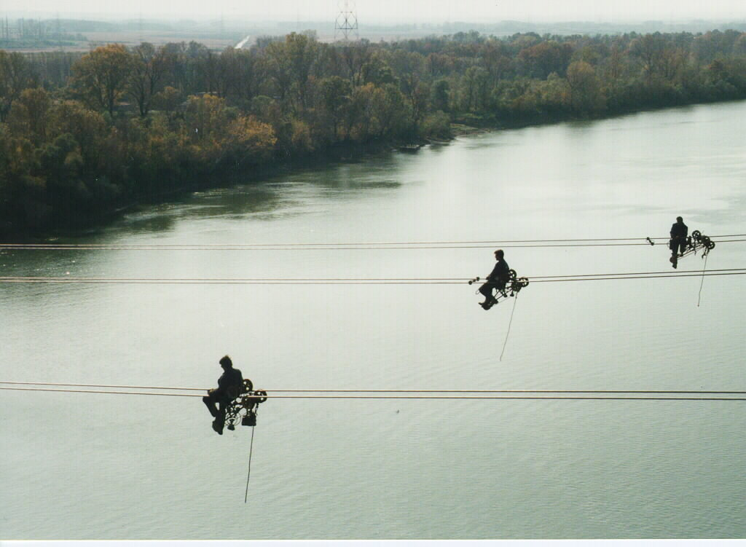
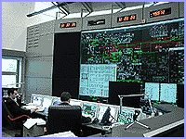

http://www.ems.rs
Notes:
23

